Slide 1
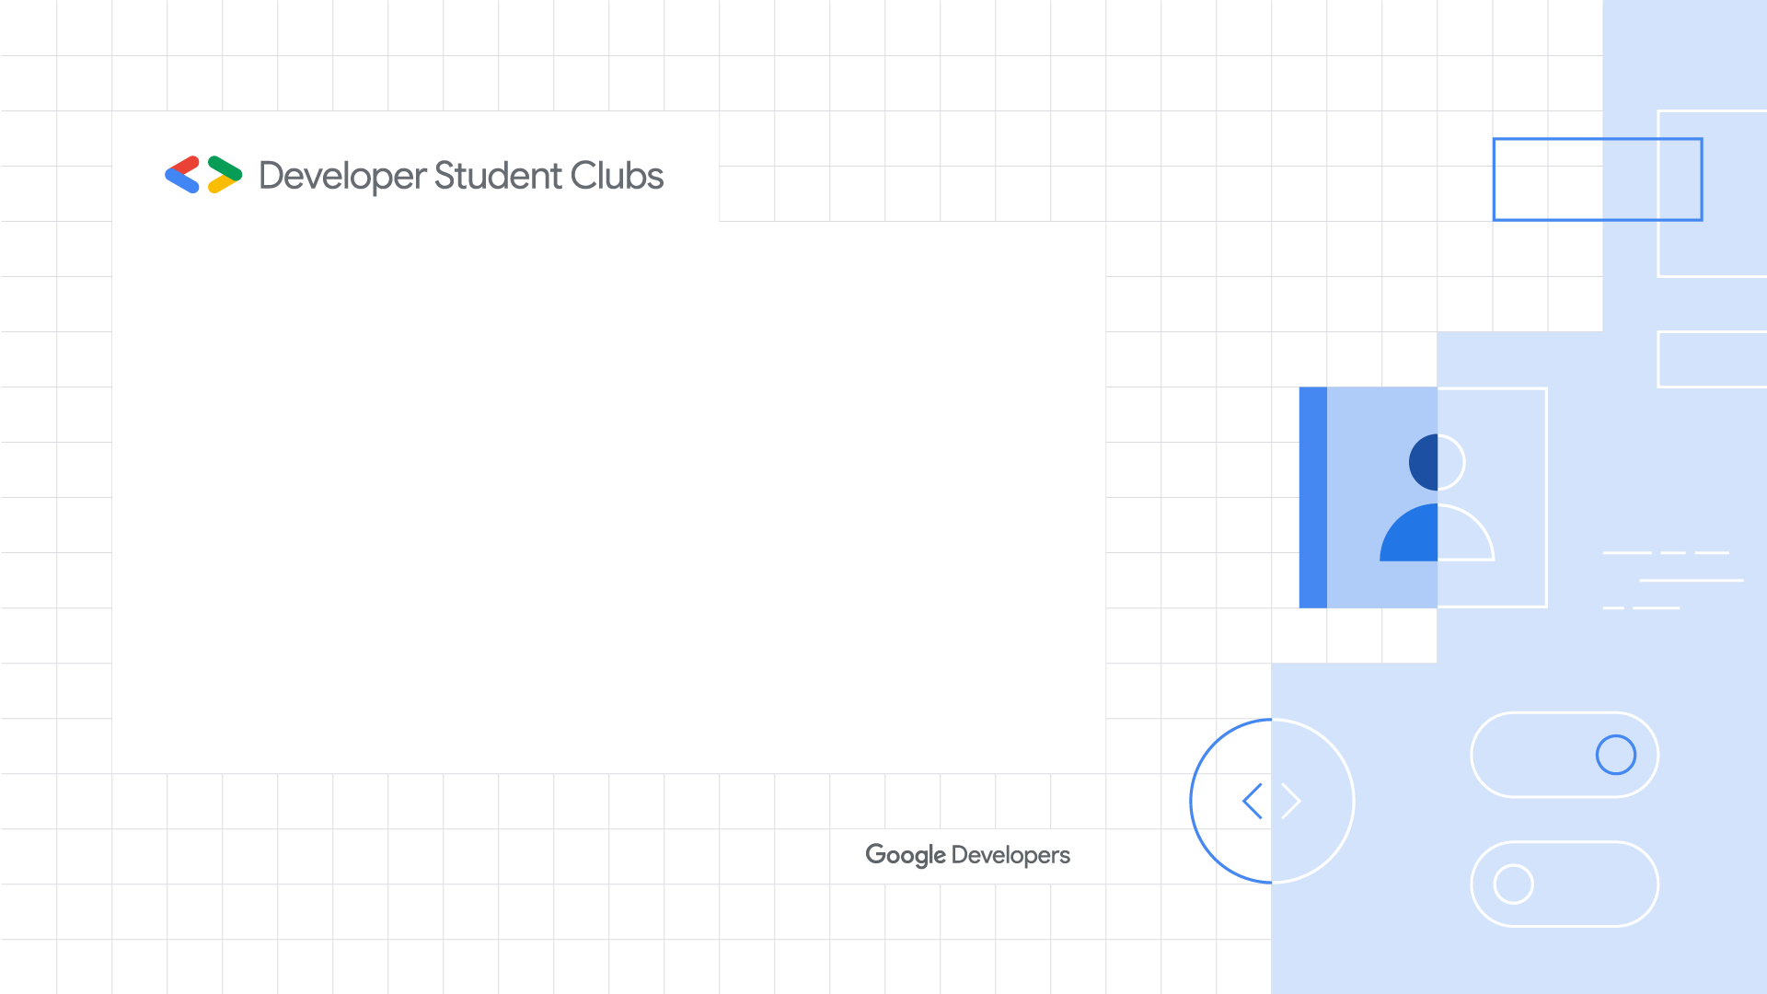
Brand guide
and meetup kit
Updated 10.22.19

Slide 2
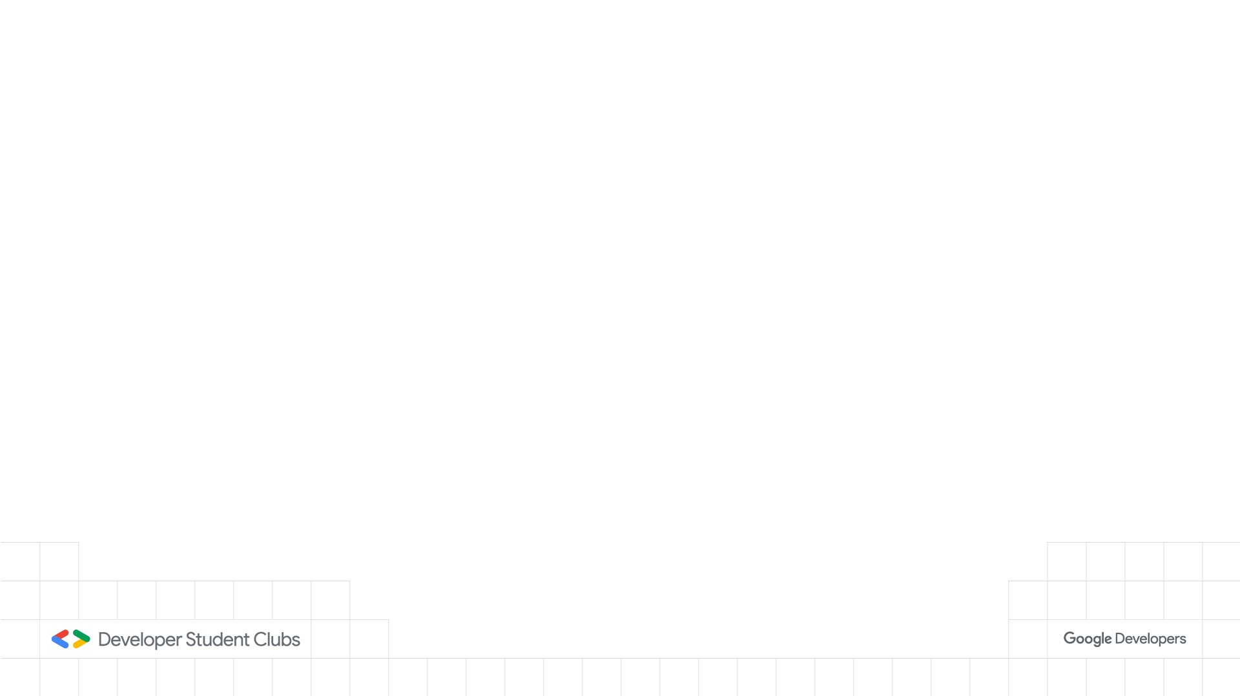
Contents
Brand vision
Brand foundations Google Developers brand Color Logo Adding partner logos Regional chapter logo do’s Regional chapter logo don’ts Photography Typography Typography do’s Typography don’ts
Digital assets Social media Social media promotions Web graphics Slide/presentation templates Email template
Swag Examples T-shirt examples Stickers Merchandise best practices
Event assets Event Badges Signage - Letter Signage - Poster Signage - Half meterboards Signage - Meterboards Logo printing examples

Slide 3
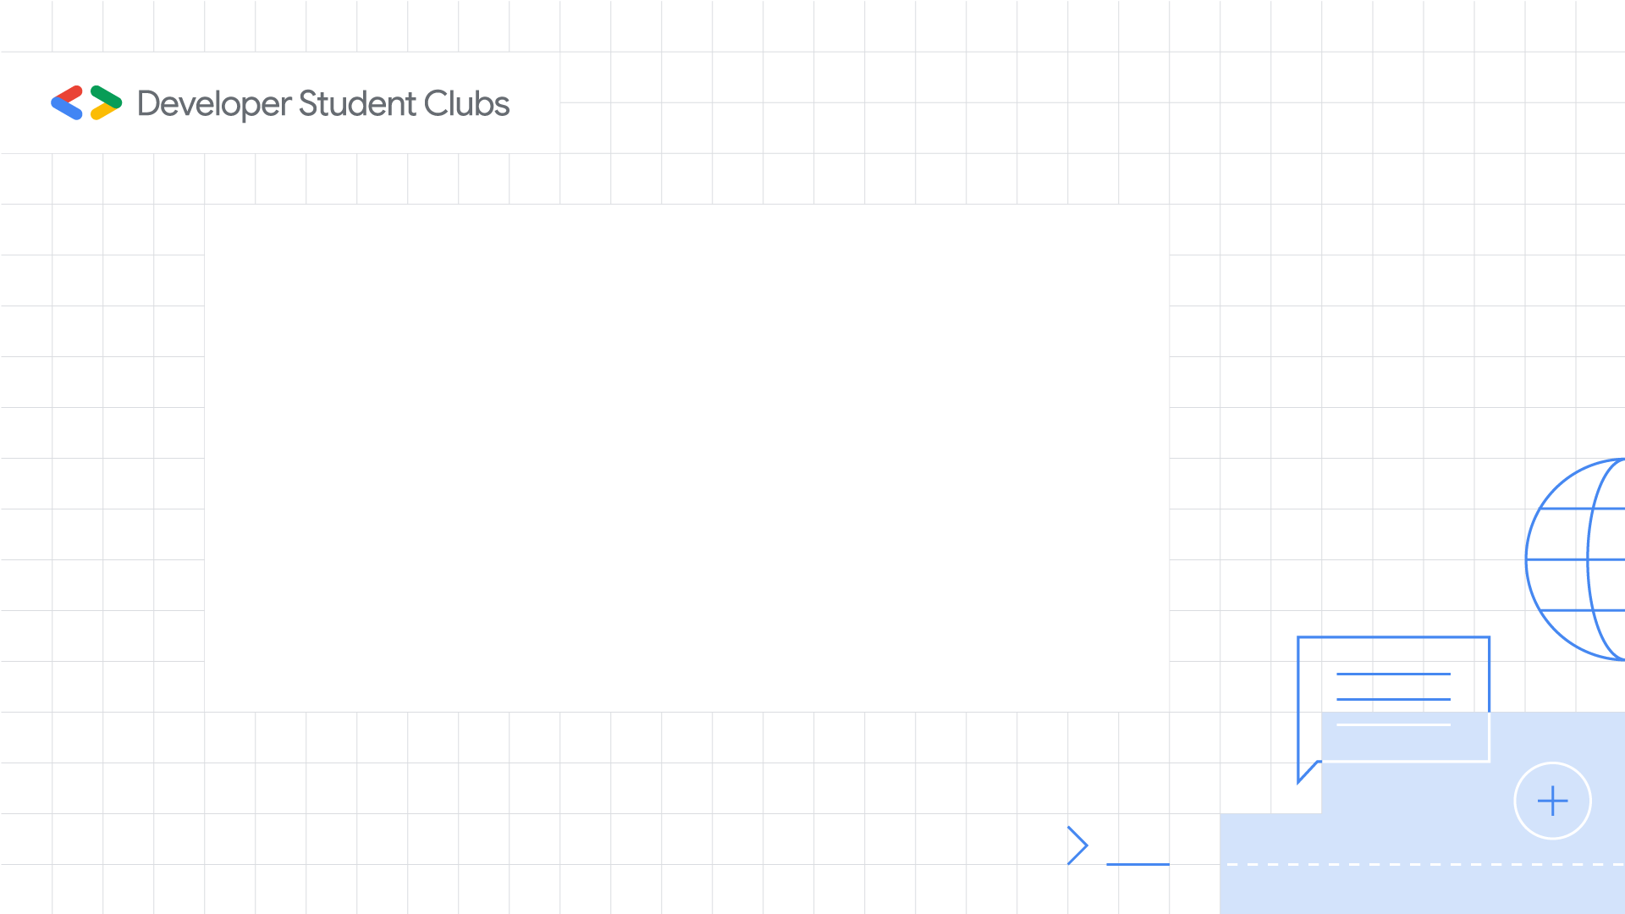
Our Vision
Reference the themes of these core messages when communicating about your club or community:
Developer Student Clubs help students bridge the gap between theory and practice.
These university-based communities cater to students interested in Google developer technologies. Students grow their knowledge in a peer-to-peer learning environment while building solutions for local businesses. Developer Student Clubs is a community where everyone is welcome.
Developer Student Clubs is a program supported by Google Developers.

Slide 4

Brand foundations
Developer Student Clubs - Brand guide and meetup kit

Slide 5



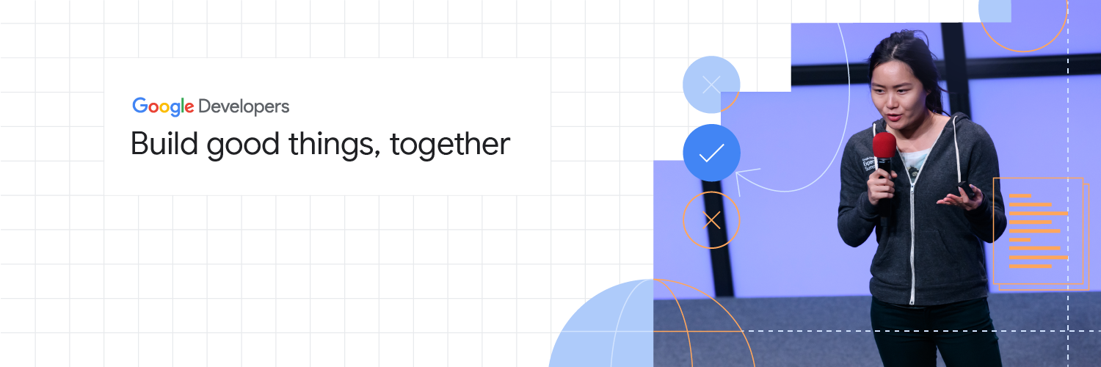
Developer Student Clubs - Brand guide and meetup kit
Developer Student Clubs is part of our flagship brand, Google Developers.
Everything from the fonts, colors, logos, graphics, images, and tone carries through.
Why are brand guidelines important?
Aligns our community with Google’s brand, aesthetic and mission.
Helps present our community as professional and of a high quality.
Builds and grows our community with a globally consistent and recognized vision.
The 4-color Google Developers logo Download
The refreshed bracket icon Download
Aligned art and visuals Download

Slide 6
Colors
Developer Student Clubs - Brand guide and meetup kit
Hex #174EA6 r23 g78 b166 c100 m60 y0 k20 PMS 301 Coated
Hex #A50E0E r165 g14 b14 c0 m95 y100 k25 PMS 7628 Coated
Hex #E37400 r227 g116 b0 c0 m65 y100 k10 PMS 145 Coated
Hex #0D652D r13 g101 b45 c98 m0 y98 k30 PMS 349 Coated
Primary colors
Hex #185ABC r24 g90 b188 c100 m60 y0 k10 PMS 2945 Coated
Hex #B31412 r179 g20 b18 c0 m95 y100 k15 PMS 7627 Coated
Hex #EA8600 r234 g134 b0 c0 m60 y100 k5 PMS 144 Coated
Hex #137333 r19 g115 b51 c98 m0 y98 k20 PMS 348 Coated
Use the Google Developers primary color palette in assets or communications.
White is the most important color in our palette. It provides simplicity and clarity to our visuals, and it’s the foundation of all Google designs, illustrations, and environments. As a core color, White 0 should always be used more than any other color in your composition.
Use the primary colors to create focus. Pair core colors with neutrals and a white background to bring dimension and focus to an illustration.
Hex #1967D2 r25 g103 b210 c100 m55 y0 k5 PMS 2935 Coated
Hex #C5221F r197 g34 b31 c0 m95 y100 k10 PMS 7626 Coated
Hex #F29900 r242 g153 b0 c0 m50 y100 k5 PMS 2012 Coated
Hex #188038 r24 g128 b56 c98 m0 y98 k10 PMS 347 Coated
Hex #1A73E8 r26 g115 b232 c95 m50 y0 k0 PMS 2174 Coated
Hex #D93025 r217 g48 b37 c0 m95 y100 k0 PMS 7597 Coated
Hex #F9AB00 r249 g171 b0 c0 m45 y100 k0 PMS 130 Coated
Hex #1E8E3E r30 g142 b62 c98 m0 y98 k0 PMS 7482 Coated
Core Colors (logo)
Hex #4285F4 r66 g133 b244 c88 m40 y0 k0 PMS 2173 Coated
Hex #EA4335 r234 g67 b53 c0 m87 y89 k0 PMS 179 Coated
Hex #FBBC04 r251 g188 b4 c0 m37 y100 k0 PMS 7549 Coated
Hex #34A853 r52 g168 b83 c85 m0 y92 k0 PMS 2257 Coated
Hex #D2E3FC r210 g227 b252 c19 m2 y0 k0 PMS 290 Coated
Hex #FAD2CF r250 g210 b207 c0 m15 y9 k0 PMS 705 Coated
Hex #FEEFC3 r254 g239 b195 c0 m5 y22 k0 PMS 9141 Coated
Hex #CEEAD6 r206 g234 b214 c14 m0 y18 k0 PMS 9560 Coated
Hex #E8F0FE r232 g240 b254 c7 m0 y0 k0 PMS 9040 Coated
Hex #FCE8E6 r252 g232 b230 c0 m9 y3 k0 PMS 9021 Coated
Hex #FEF7E0 r254 g247 b224 c0 m2 y10 k0 PMS 9064 Coated
Hex #E6F4EA r230 g244 b234 c10 m0 y12 k0 PMS 9525 Coated

Slide 7


Logo
Developer Student Clubs - Brand guide and meetup kit
Download logo files
Use the logo in these formats only.
While the horizontal logo is preferred, the stacked logo can be used as an alternative when space is a limiting factor.
The full color logo lockup should only be used on either white and grey backgrounds.
The white version should only be used on top of a background color from the Google Developers primary color palette or on photographs that are not too busy.
Horizontal (preferred)
Stacked

Slide 8
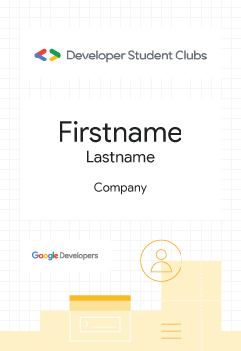
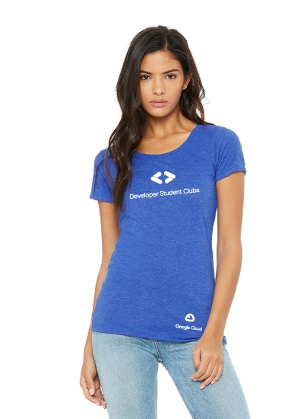
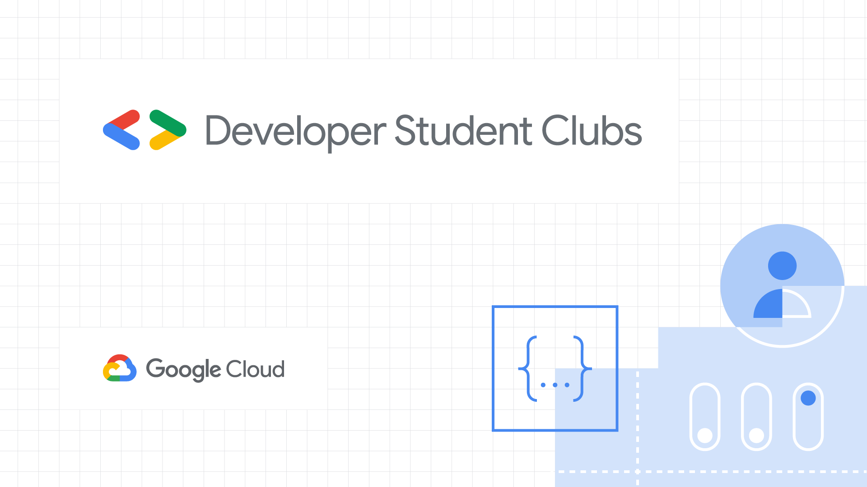


Partnership and sponsor logos
Developer Student Clubs - Brand guide and meetup kit
Always place partner logos a good distance (generally underneath) from the Developer Student Clubs logo. They cannot appear to be the same program or product.
For best results, use the assets in this deck and simply replace the Google Developers logo with the appropriate partner logo.
Avoid using more than one partner logo on an asset. If more than one partner is required, it’s probably best to use the Google Developers logo.

Slide 9

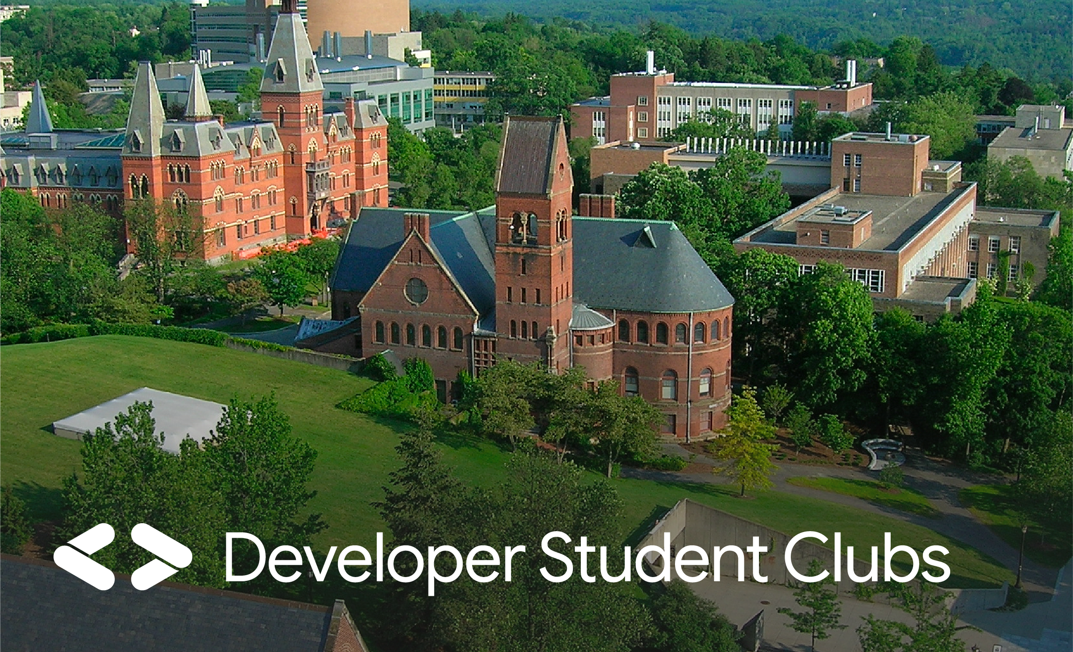
Developer Student Clubs - Brand guide and meetup kit
Logo lockups for local chapters do’s
Chapter lockup generator
Do Customize the logo lockup for your chapter using the logo lockup generator tool and follow the naming guidelines shown.
Do refer to your chapter as [“Developer Student Club [University/School]”.
Do Use the black or white “knockout” version of the logo against grey or black backgrounds. The knockout version can also be placed on photographs provided that the image does not interfere with the legibility of the logo.
Do If you want to further customize your assets, create a visual asset that can be shown in addition to but NOT as part of the lockup. The spacing around the lockup should at a minimum match the height of the <> brackets in the logo.
Do refer to the program as [“Developer Student Clubs”] in plain text or conversation without the logo lockup.

Slide 10
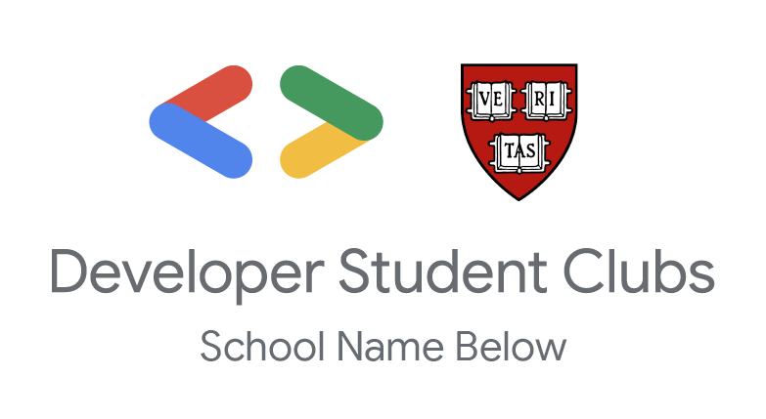






Developer Student Clubs - Brand guide and meetup kit
Logo lockups for local chapters don’ts
UC Berkeley
Don’t Use the Google Developers name or lockup to represent your chapter. Always use the [Developer Student Clubs] lockup generator OR the main [Developer Student Clubs] lockup instead (but don’t use both at the same time). If you want to use the Google Developers logo in addition to the Developer Student Clubs logo, they must be far away from each other on any given medium.
Don’t Add additional elements to the lockup, or alter the lock up or logo with additional assets, changes of color, etc.
Don’t Name your chapter with a “Location” that is a state, country, region, or continent (e.g. California, France, EMEA, Africa).
Don’t Localize the lockup in a non-English language. Always use [“Developer Student Club”] and your location in English and localize communications instead.
Don’t Alter or distort the official lockup in any way, including altering fonts, colors, shapes, proportions, or rotating/flipping it in any direction.
Don’t Use the acronym DSC as a logo lockup.
Don’t Use the lockup on a poorly contrasting or busy background.
Don’t Overlap or crowd the lockup with other custom elements including text or artwork.
Don’t Place logo over busy photograph.

Slide 11
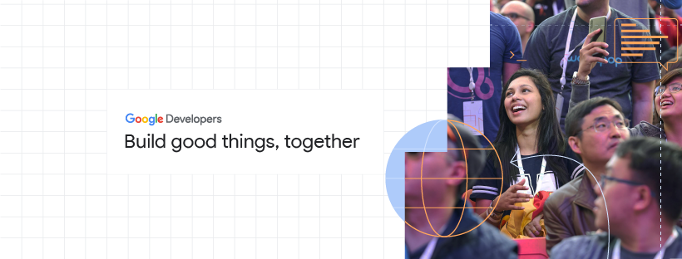

Photography
Developer Student Clubs - Brand guide and meetup kit
Use photography to communicate Google’s values of inclusivity, empowerment and strength in community.
Prioritize and focus on individuals.
Capture smiling faces.
Focus on actions that communicate what Google Developers is about (people coding together, working on laptops, listening to talks, giving talks, networking).
Avoid focusing on "party" photos.
Make sure photos are clear, with good lighting and of high resolution. Avoid sharing blurry photos.
Integrate the developer line art style as needed to reiterate Google’s developer-centric branding.

Slide 12
Developer Student Clubs - Brand guide and meetup kit
Typography
Download Google Sans
Headlines
General
Google Sans Bold
Use Google Sans Bold for headlines.
Use Google Sans Regular for subheads and body copy.
If smaller text is necessary such as for annotations, footnotes, or small labels, please use Roboto Normal.
Sub Head / Longer strings of text
Google Sans Regular
Body copy
Google Sans Regular
Small copy
Roboto Normal

Slide 13
Developer Student Clubs - Brand guide and meetup kit
Typography do’s
Headers and hierarchy
Applications closing soon.
Submit your information by October 1 to be considered.
Another example of a header.
With a subtitle
Submit your information by October 1 to be considered.
Use a ratio of 1½ :1 for setting the size of a header to the body copy. (Example: if your body copy 12pt in size, please set the header to 18 (12/2 = 6; 12+6=18).
Use a line spacing of between 1.15-1.5.
Add a paragraph break that is ½ the height of the header. (Example: if the header is 24pt in size, add at least a 12pt paragraph break between the header and body copy below.)
Use color to draw attention to key messages in the typography.
Do
Left align text and ensure comfortable spacing between lines
Do
Use the same size for headers and subheaders. Apply Google Sans Regular to the subheaders to create appropriate hierarchy.

Slide 14
Developer Student Clubs - Brand guide and meetup kit
Typography don’ts
Headers and hierarchy
Applications closing soon.
Submit your information by October 1 to be considered.
Applications closing soon.
Submit your information by October 1 to be considered.
Applications closing soon.
Submit your information by October 1 to be considered.
Don’t
Do not use bold for subheaders or body copy. Reserve bold typography for headers.
Don’t
Do not use color for a full body of text. Reserve color usage to the key element of a message that deserves the most attention
Don’t
Do not use highlights or any other typographic treatment for headers. Lean on Google Sans bold and pops of color to draw attention to content when necessary.

Slide 15
Developer Student Clubs - Brand guide and meetup kit
Typography don’ts
APPLICATIONS CLOSING SOON
Applications closing soon.
Applications closing soon.
Applications closing soon.
Sign up today!
A p p l i c a t i o n s c l o s i n g s o o n.
Don’t
Use all caps or underlined text. If you would like to emphasize something, use bold.
Don’t
Apply colors outside of the brand guidelines to any typography.
Don’t
Use italics or adjust the tracking of the text

Slide 16
Digital assets
Developer Student Clubs - Brand guide and meetup kit

Slide 17
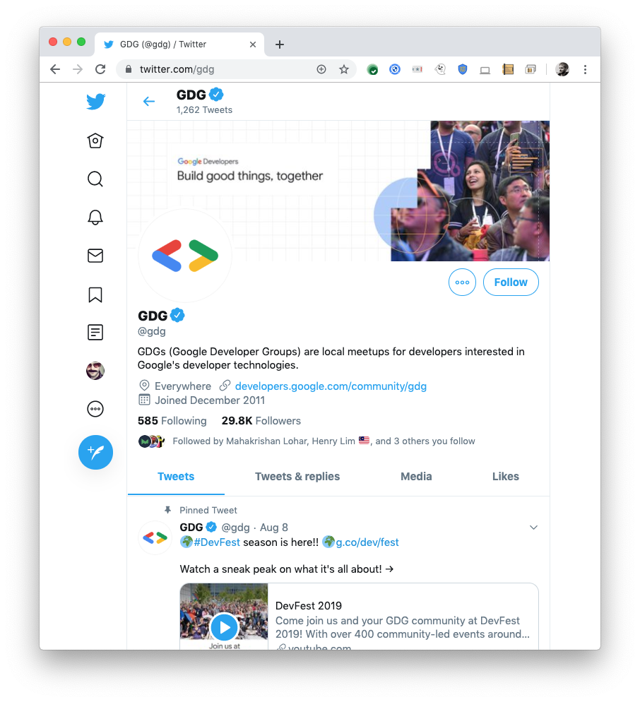
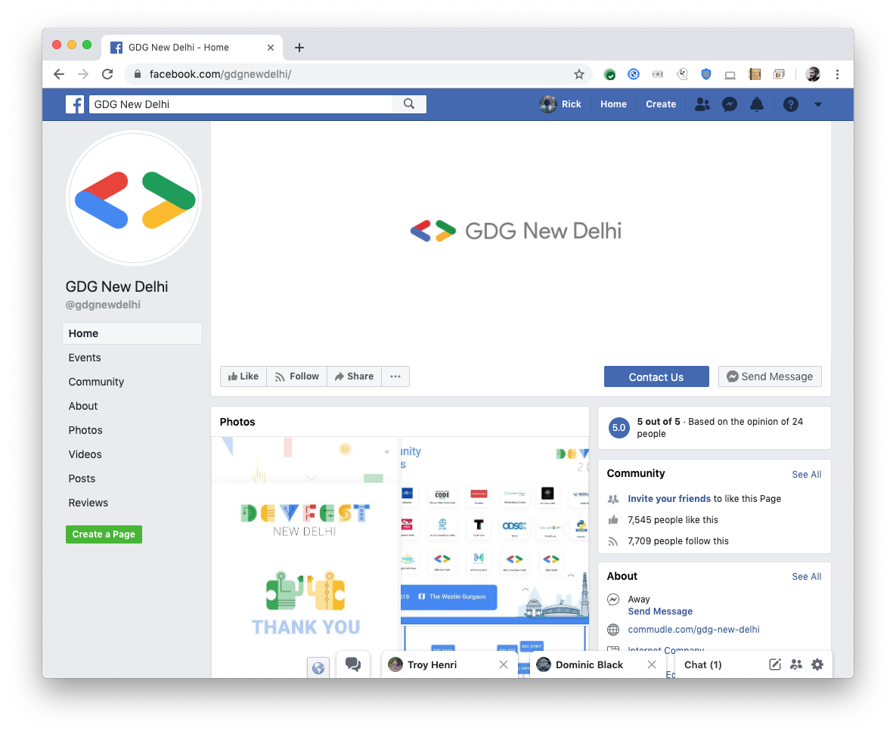

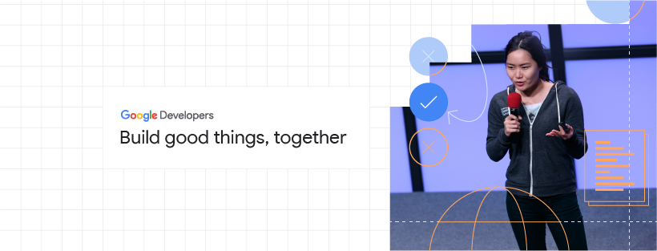

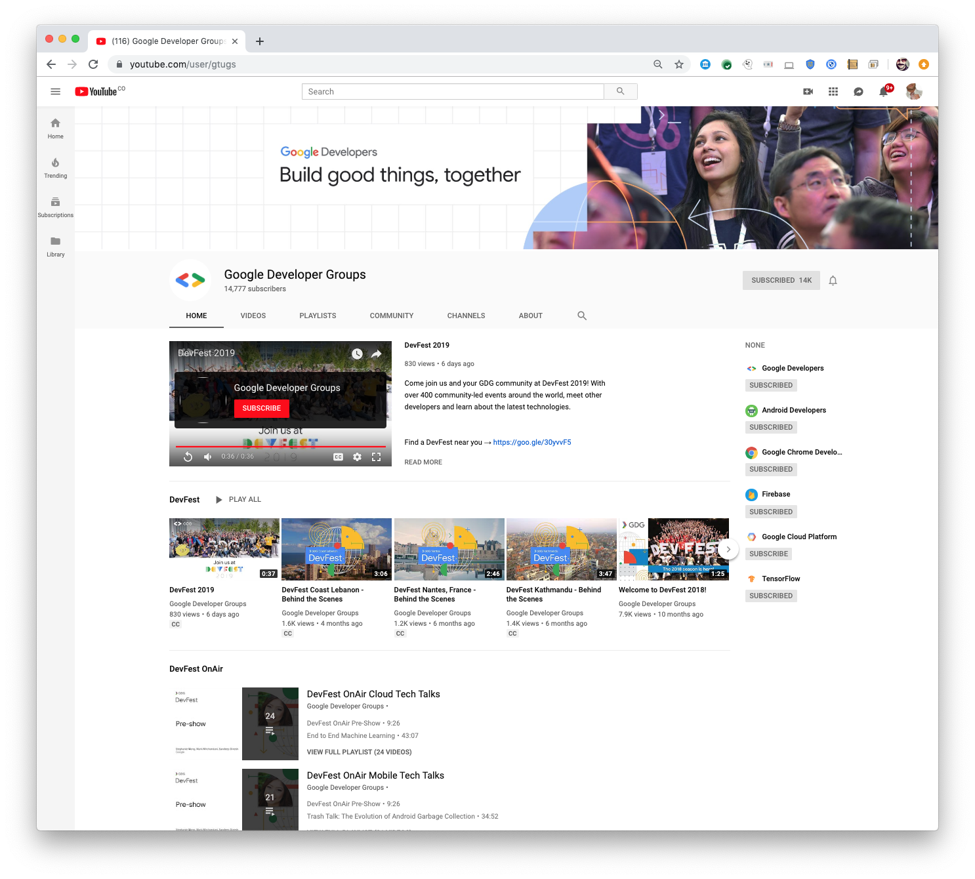
Developer Student Clubs - Brand guide and meetup kit
Social media banner graphics
Download files
If you have a social media channel(s) for your chapter, you may use these homepage header graphics. Replace the photograph(s) as desired.
Developer Student Clubs
Developer Student Clubs
Developer Student Clubs
Developer Student Clubs

Slide 18
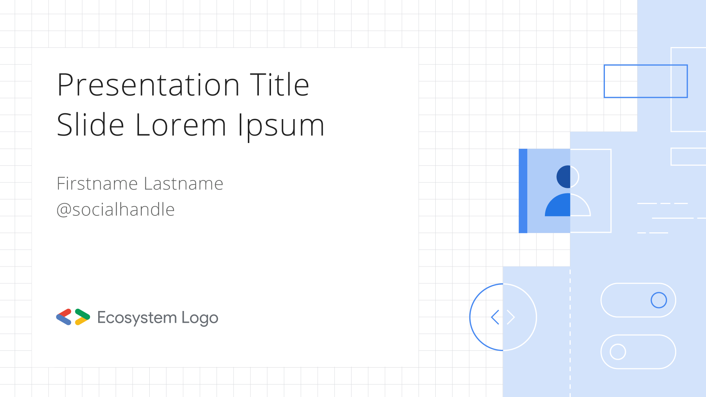
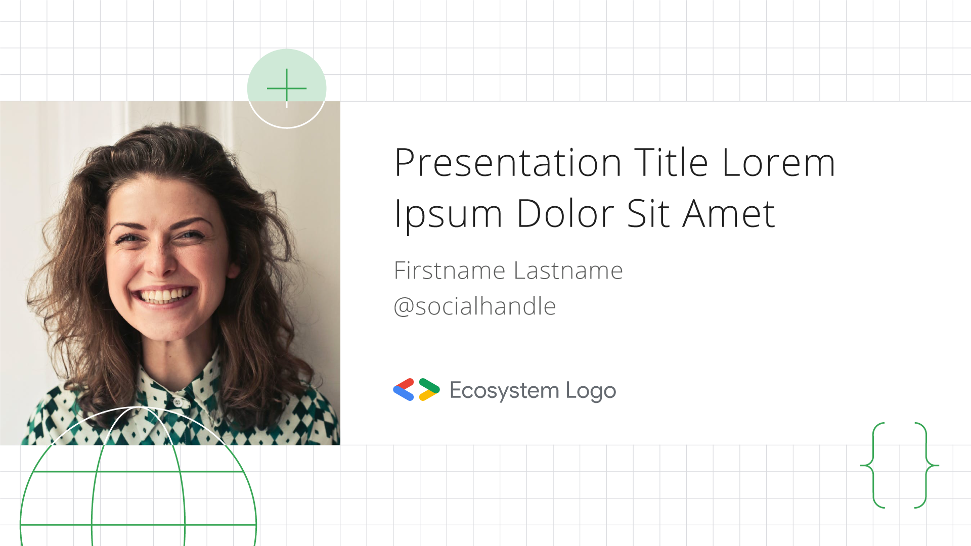
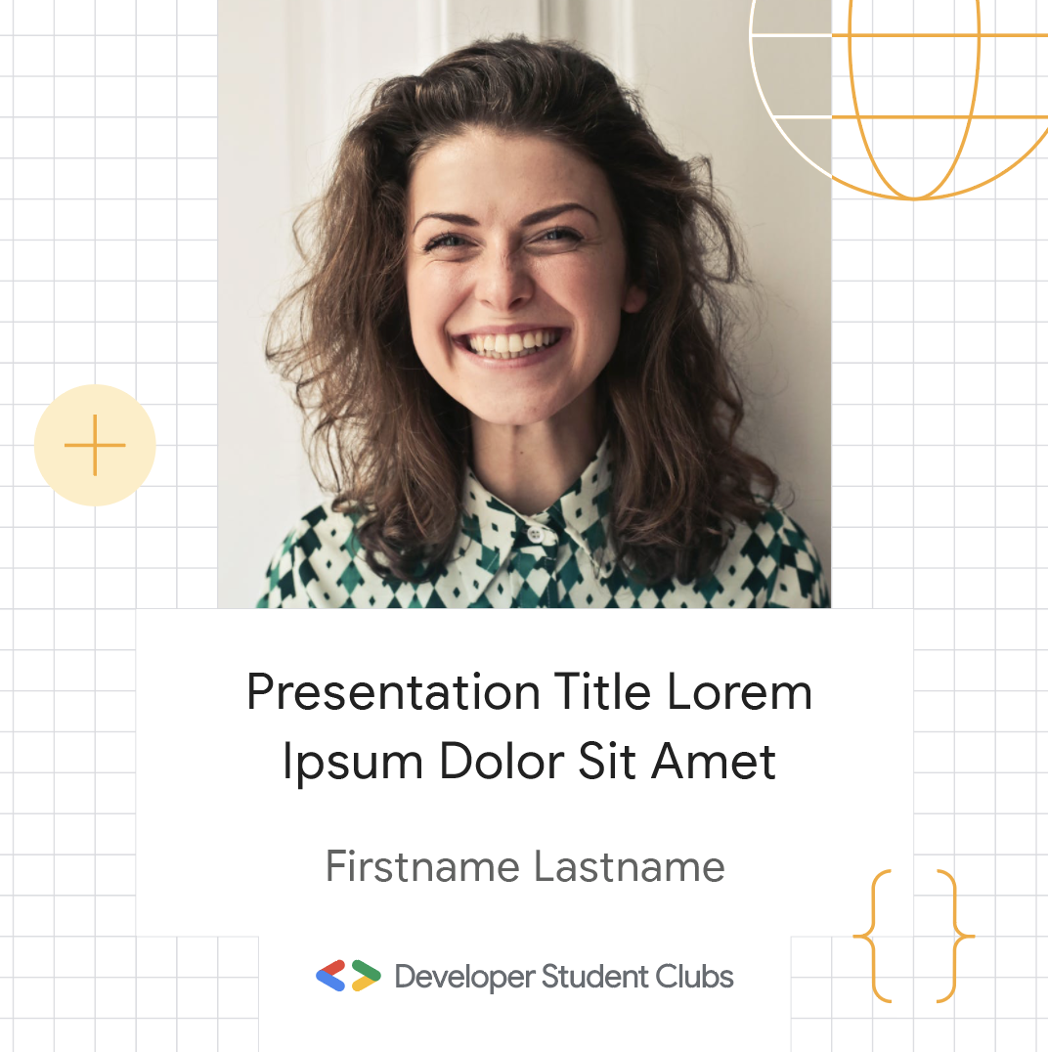
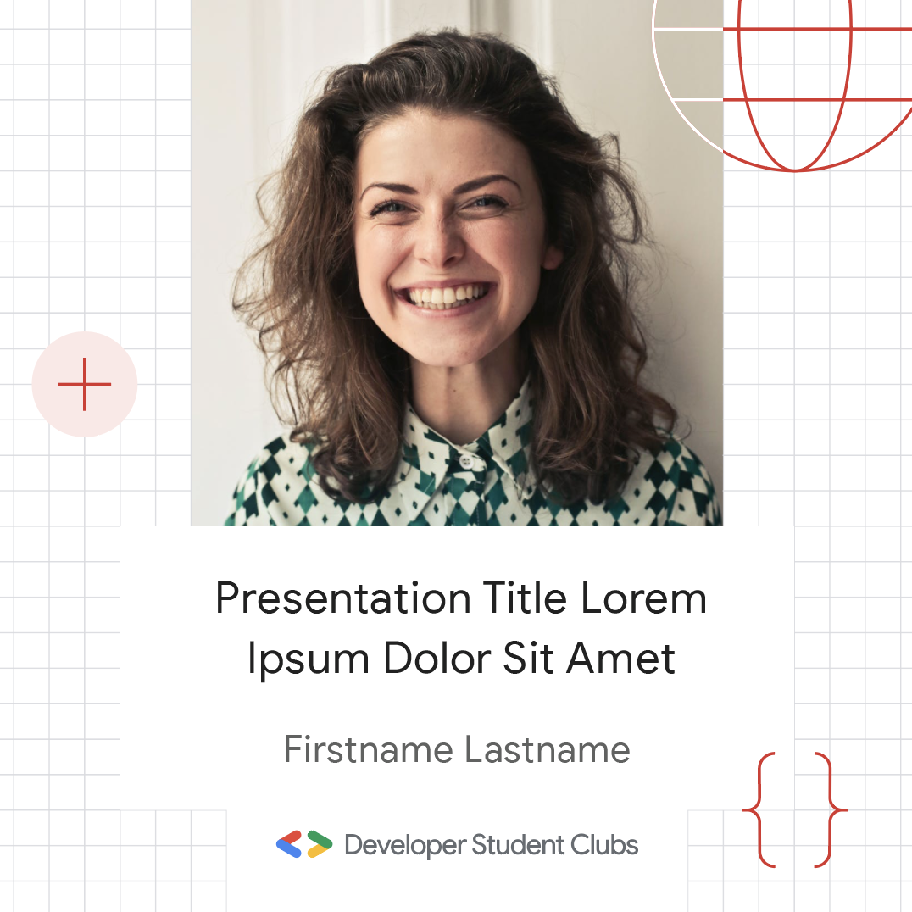
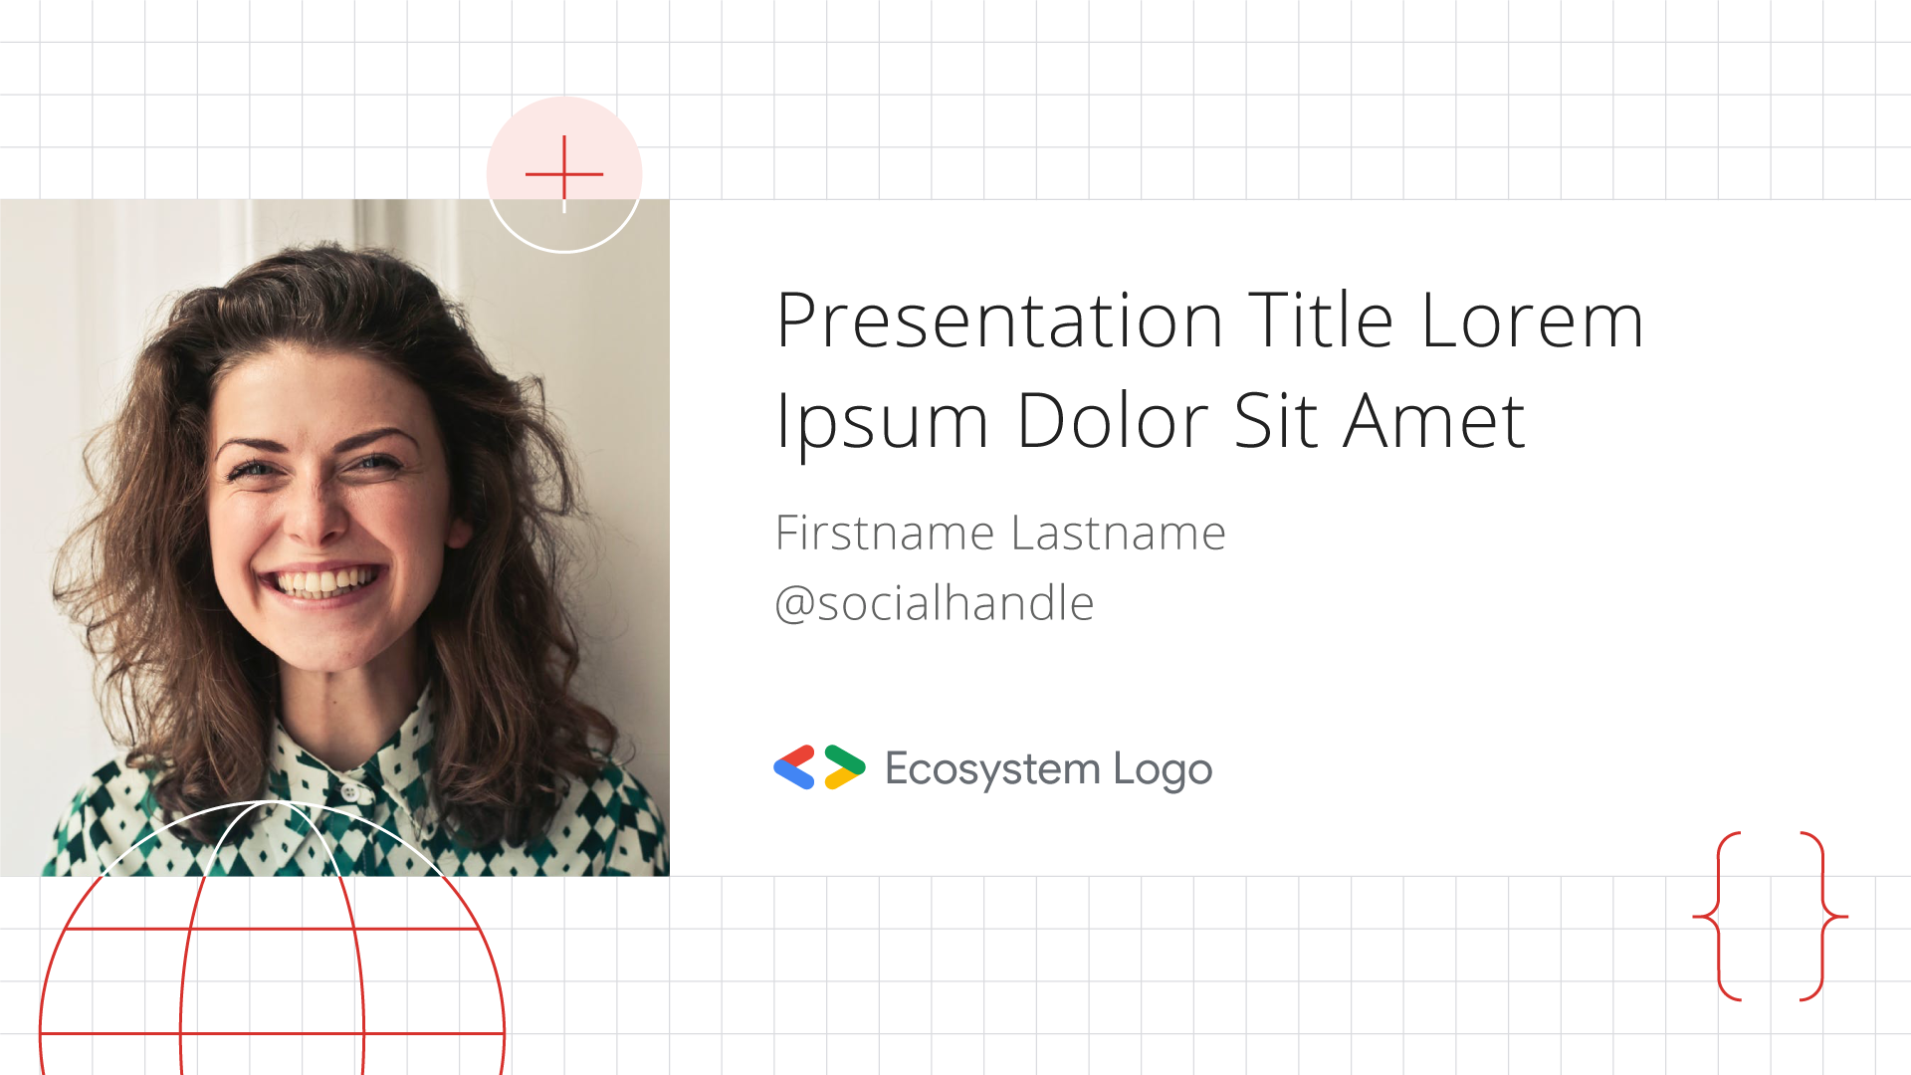
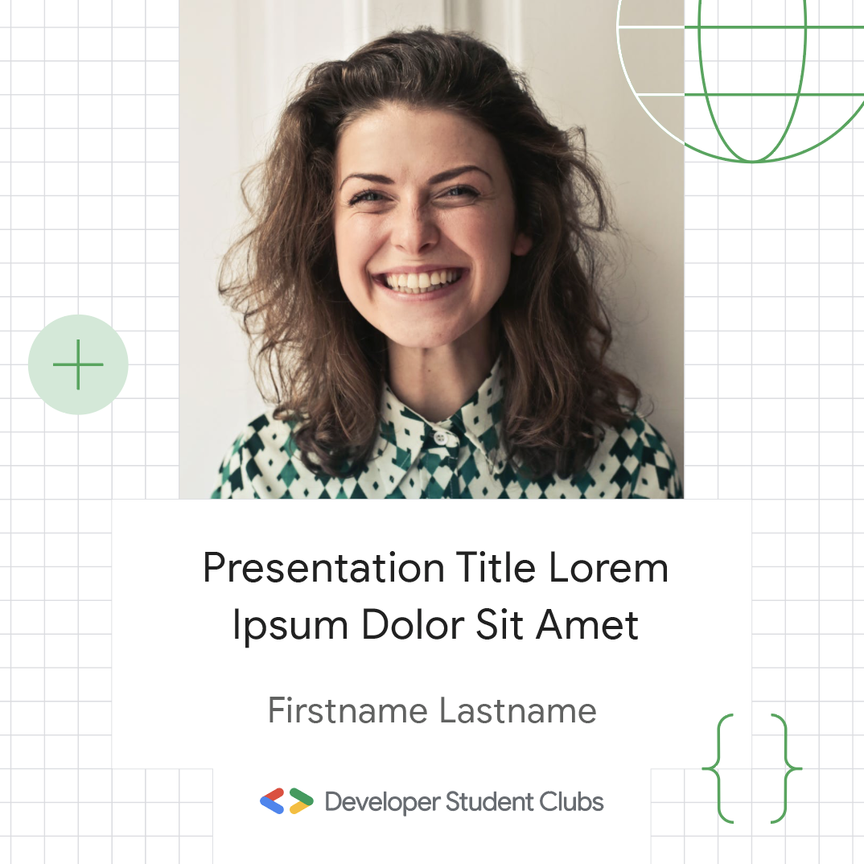
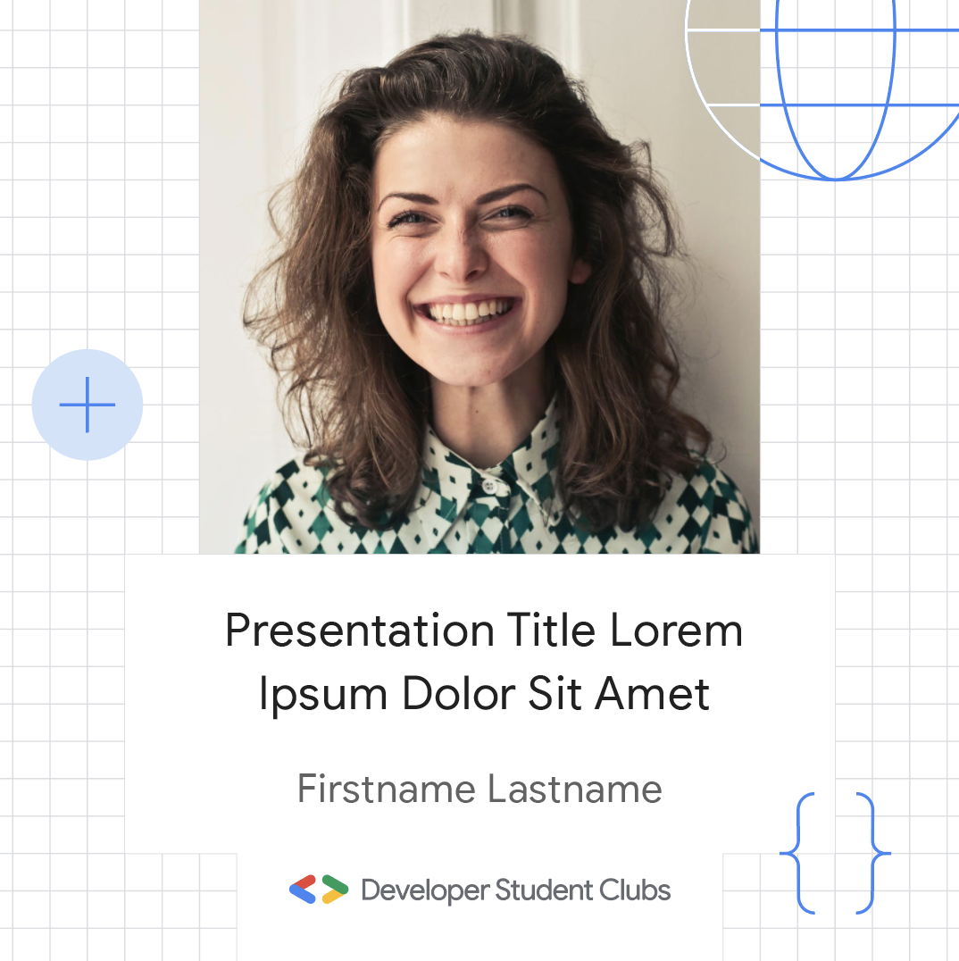
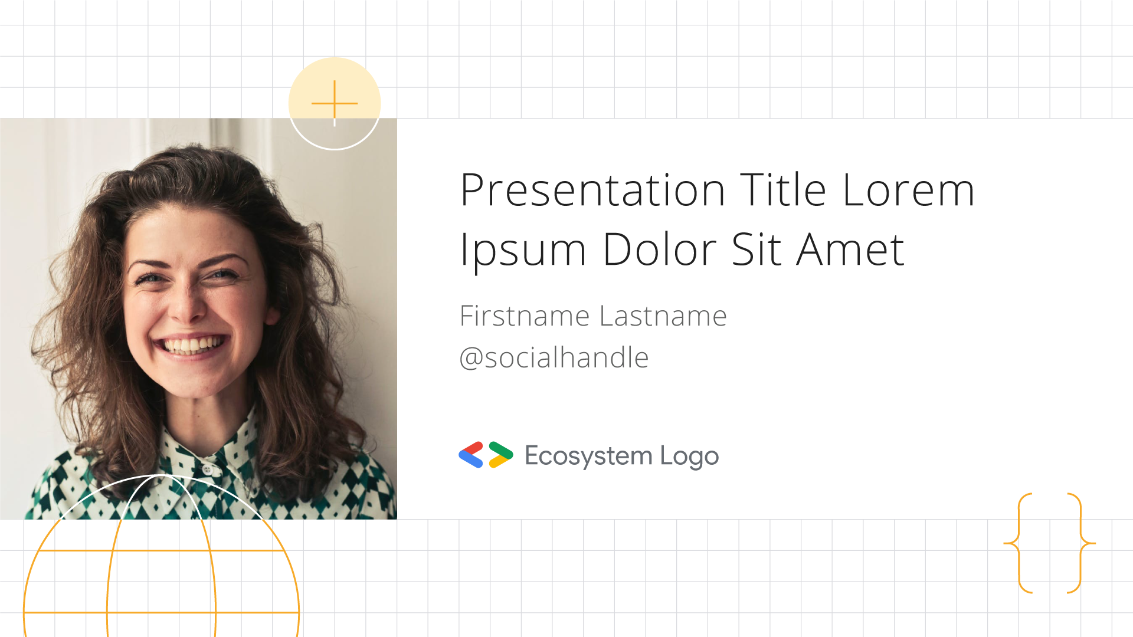


Developer Student Clubs - Brand guide and meetup kit
Social media post graphics
Download source files
Announcement of 5 to 10 words max can go here
Use these templates to make a splash with an announcement on social media.

Slide 19


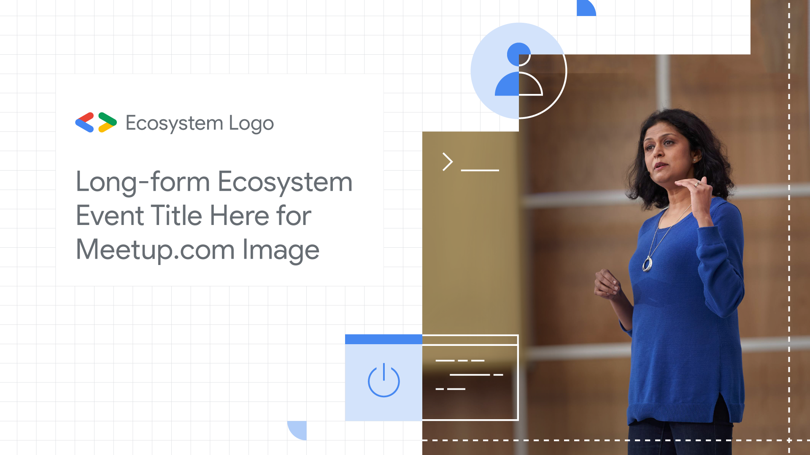


Developer Student Clubs - Brand guide and meetup kit
Web graphics
Download source files
Use these templates for homepage banners on Meetup.com or chapter websites.
Event title
goes here
Event title and text will go here
Event title
goes here

Slide 20
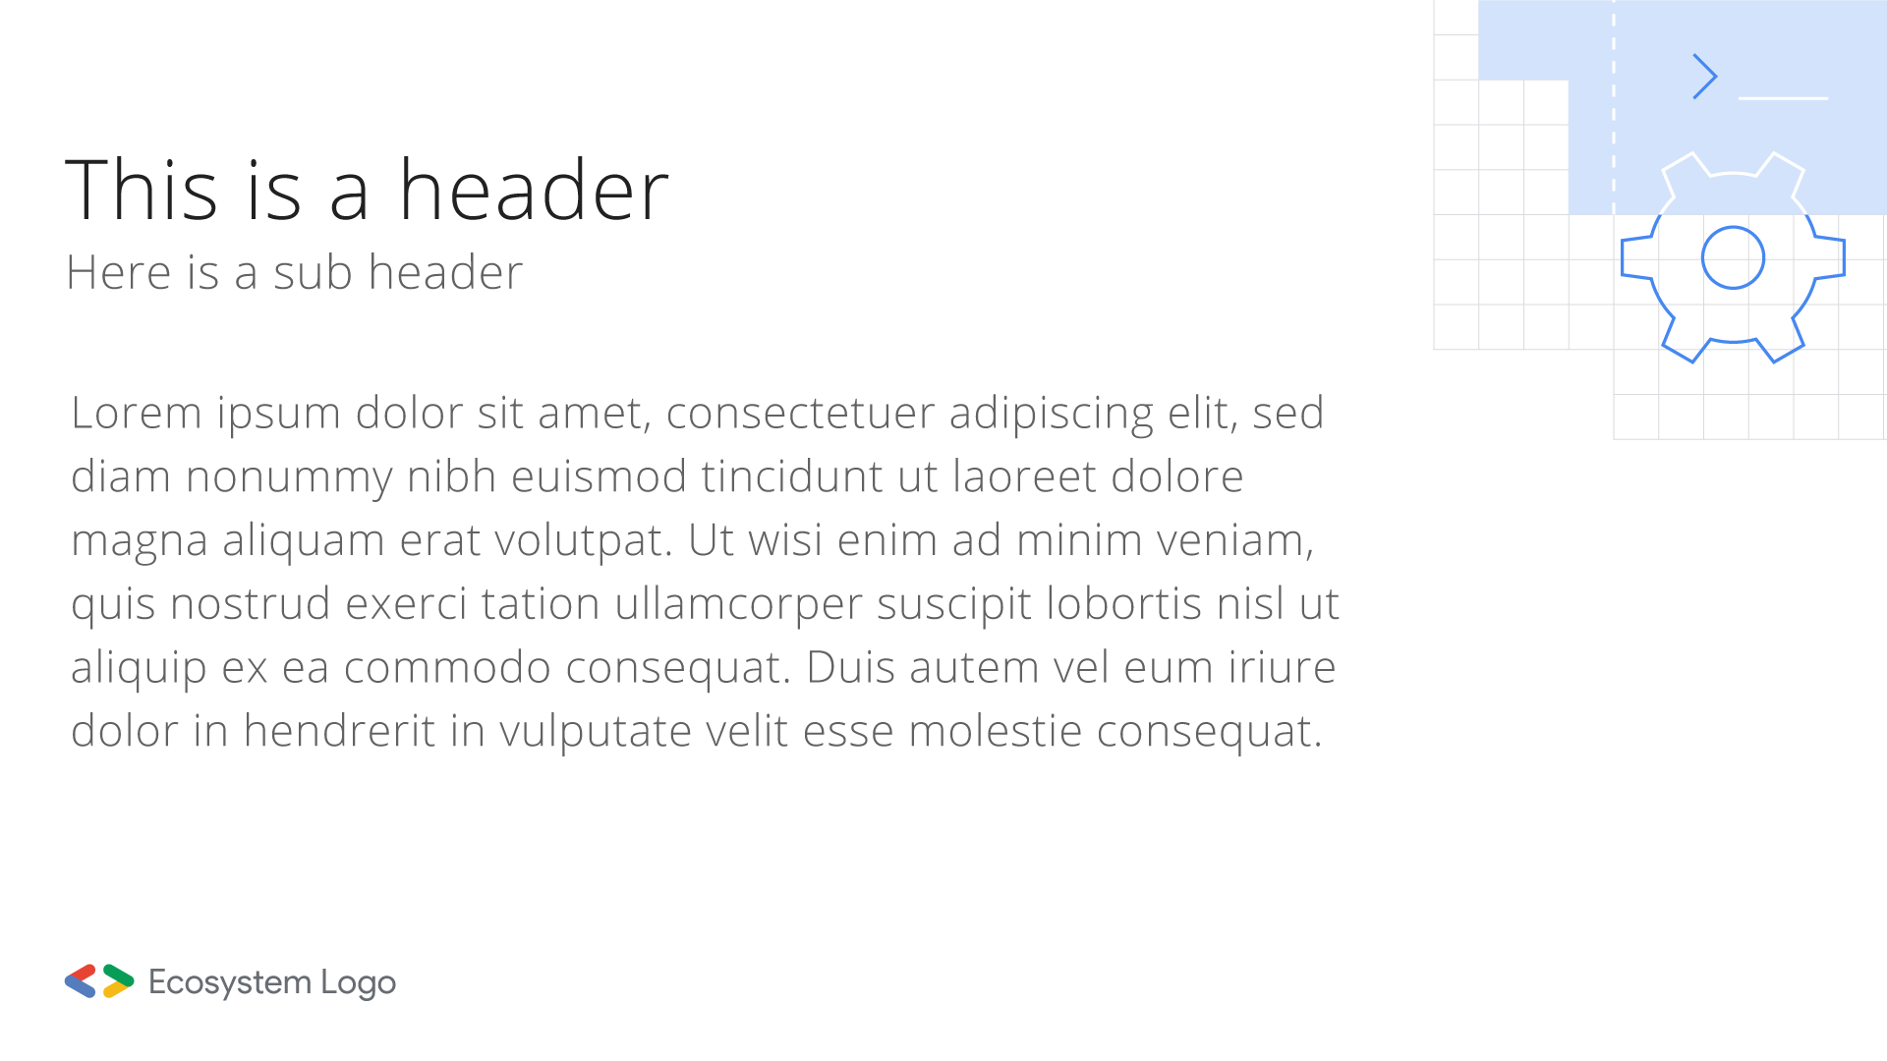
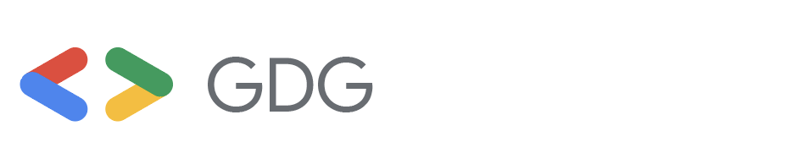
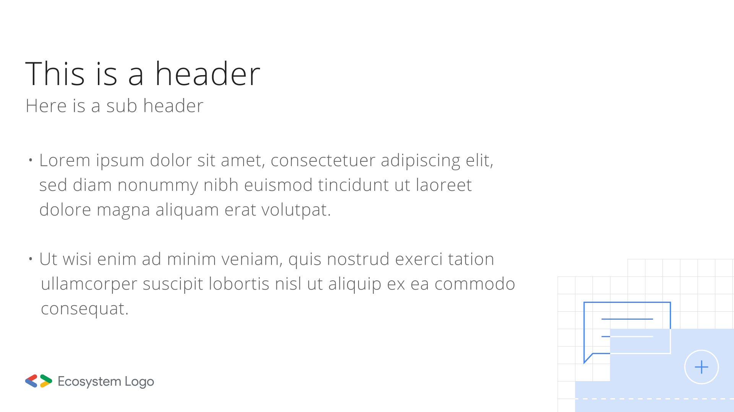
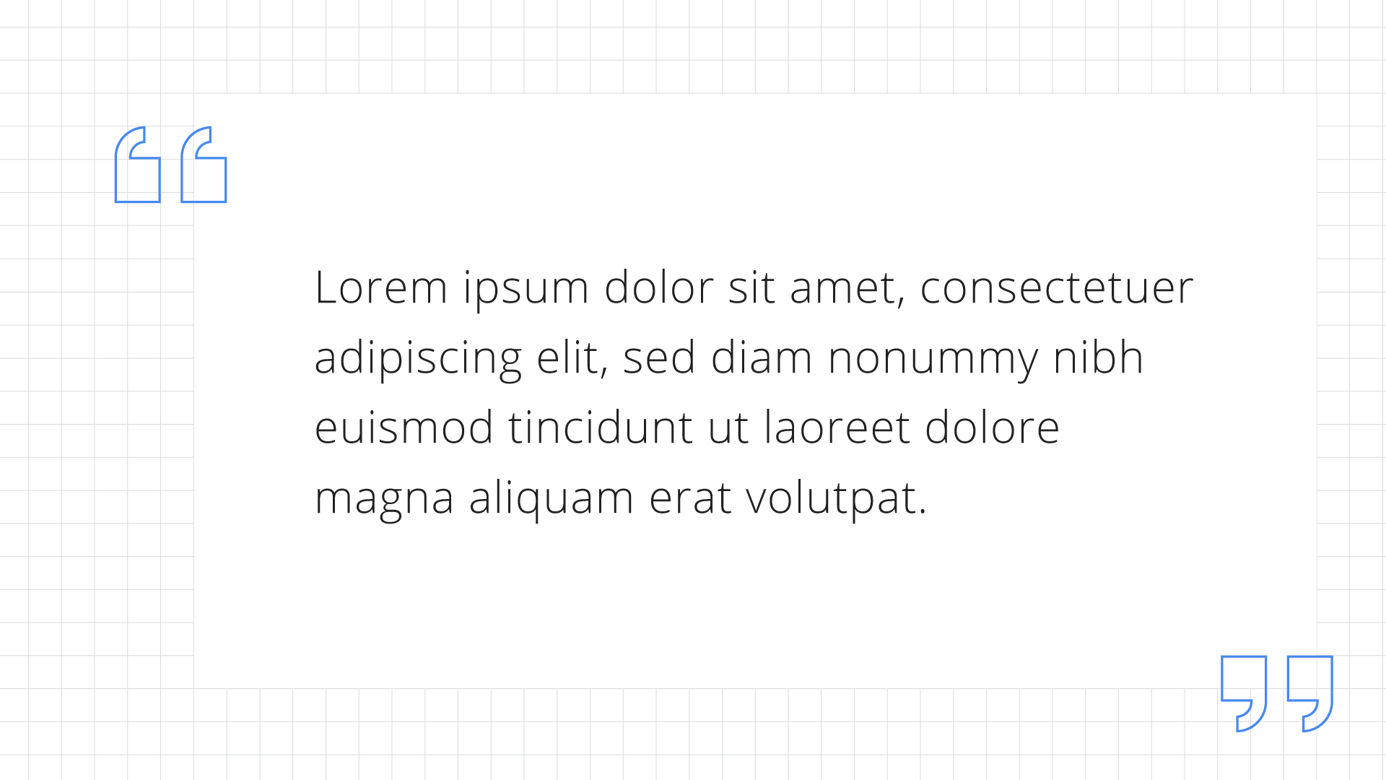
Developer Student Clubs - Brand guide and meetup kit
Slide/presentation templates
View slide template
Use this slides template when preparing presentations.

Slide 21
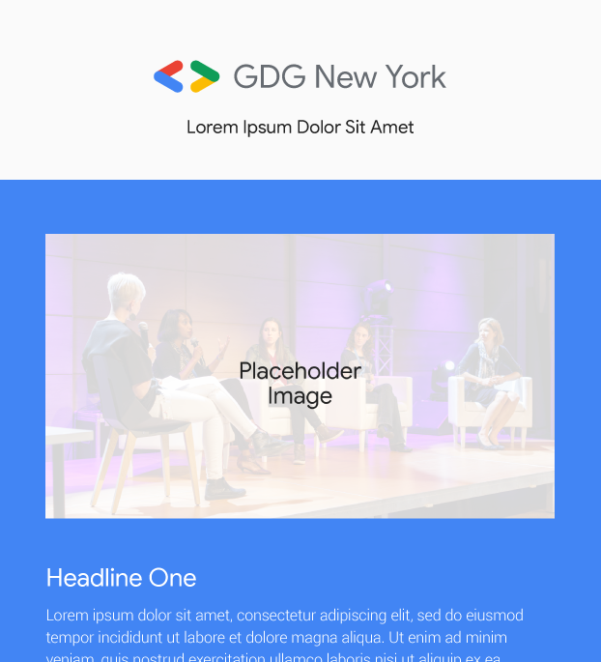
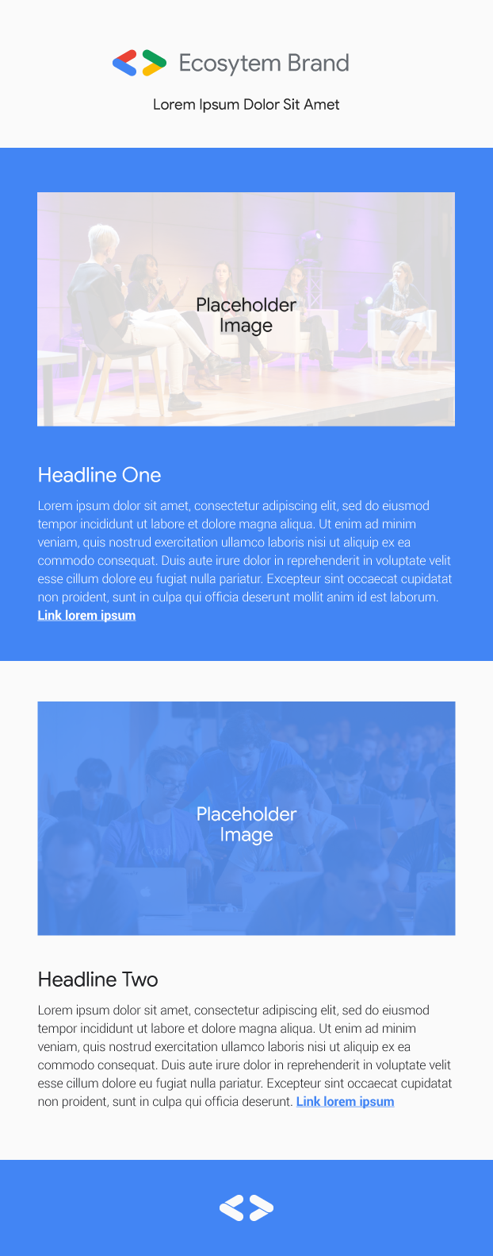
Developer Student Clubs - Brand guide and meetup kit
Email template
View email template
Use this email template when sending emails to your community.

Slide 22
Swag examples
Developer Student Clubs - Brand guide and meetup kit

Slide 23
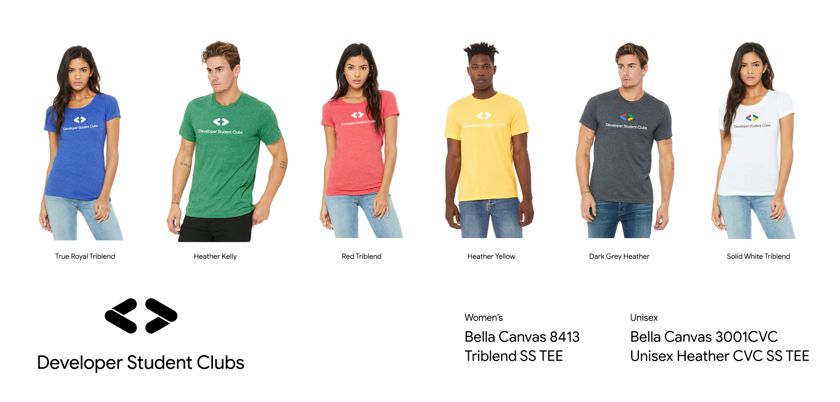
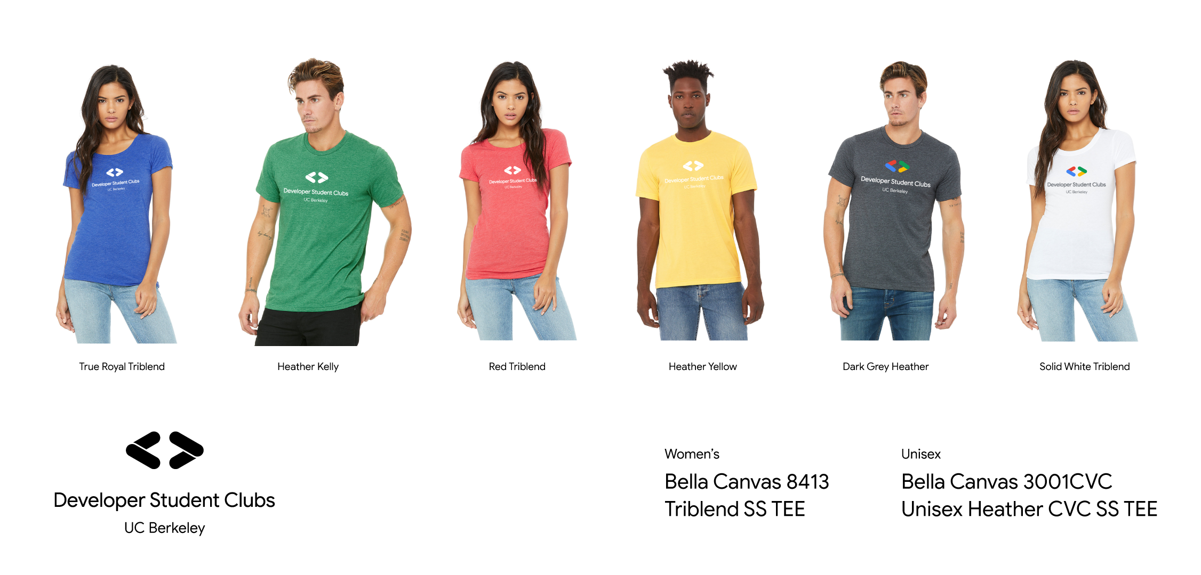
Developer Student Clubs - Brand guide and meetup kit
T-shirt examples
Download logo files | Chapter lockup generator
Print the logo on a color tee from our Google primary color palette or on black, gray or white.
If printing on a tee from the primary color palette, use the white “knockout” version of the logo. Do not print the 4-color version of the logo on a tee with one of the primary colors.
If printing on a tee that’s either grey, black or white, use the 4-color version of the logo.

Slide 24
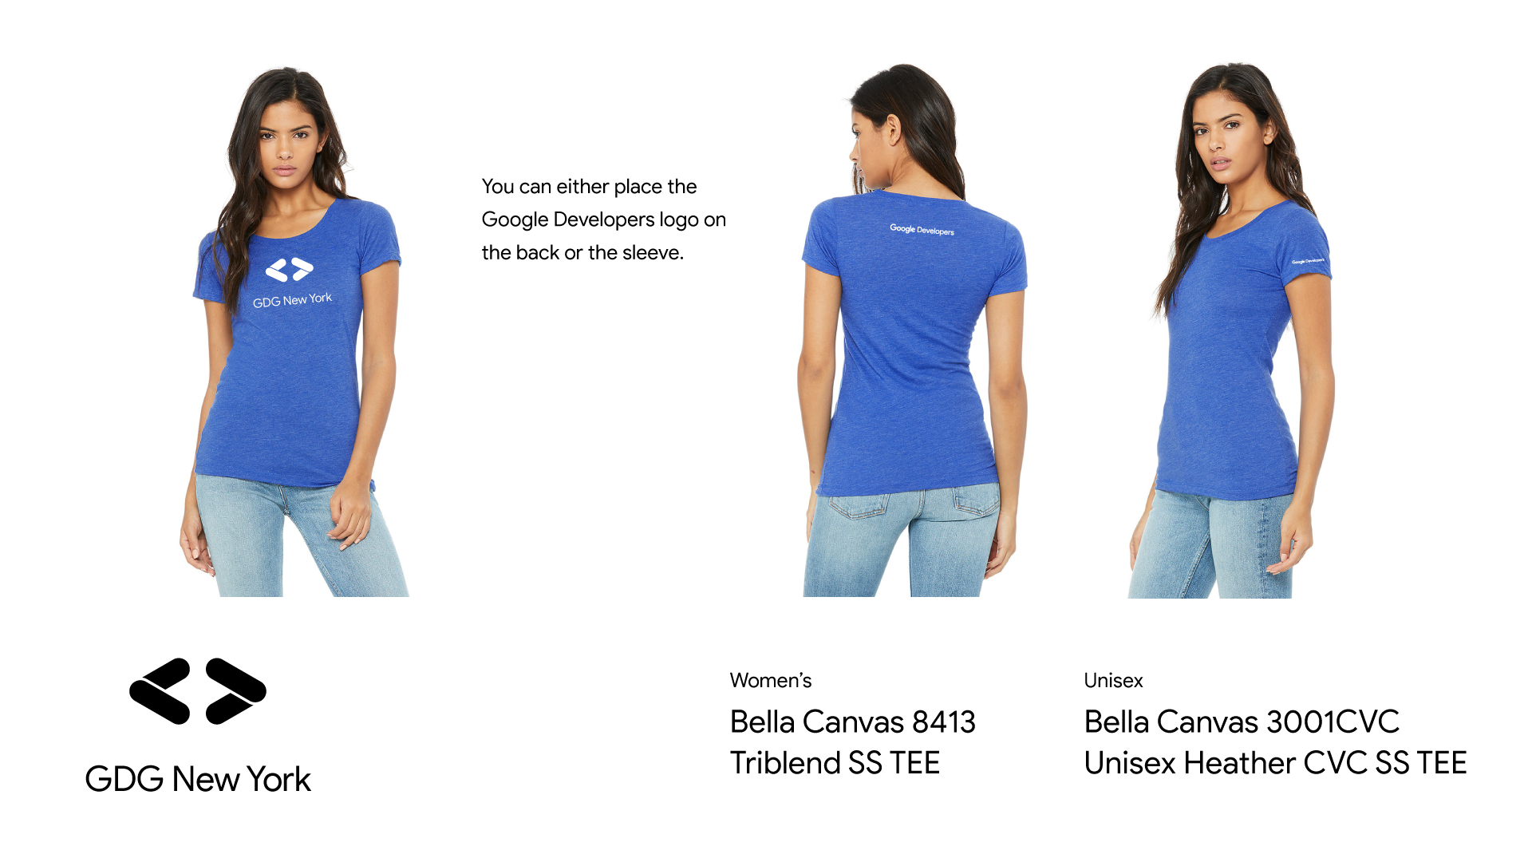
Developer Student Clubs - Brand guide and meetup kit
T-shirt examples
Download logo files | Chapter lockup generator
If adding the Google Developers logo or a partner logo, place it either on the back neckline or sleeve of tee.

Slide 25


Developer Student Clubs - Brand guide and meetup kit
Stickers
Download logo files | Chapter lockup generator
14.75” x 3”
37.4 x 7.6 cm
14.75” x 3”
37.4 x 7.6 cm
4” x 4”
10 x 10 cm

Slide 26
Developer Student Clubs - Brand guide and meetup kit
Merchandise best practices
Quality
If you wouldn’t use it, avoid it. Branded merchandise should be something you hang onto for a long time and enjoy.
Relevance
Choose items that make sense for our brand, our industry, and the topics being discussed.
Low impact
Prioritize sustainable merchandise with minimal environmental impact. Select items that are recyclable, locally sourced when possible, and enable the user to get the most out of them in the long term.
Conscientious
Pair with women- and minority-run businesses whenever possible when ordering merchandise or goods such as food and beverage.

Slide 27
Event assets
Developer Student Clubs - Brand guide and meetup kit

Slide 28
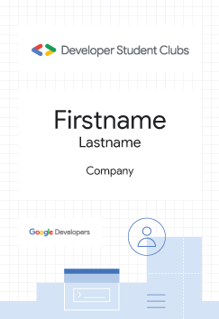
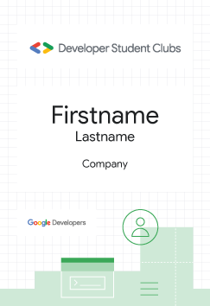
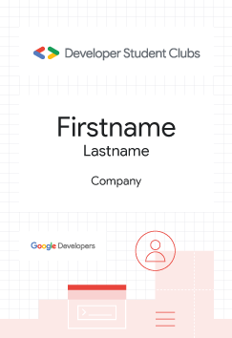
Developer Student Clubs - Brand guide and meetup kit
Event badges
Download source files
Use these event badge templates if desired and distribute at your event’s check-in or registration upon arrival for guests to identify each other.

Slide 29
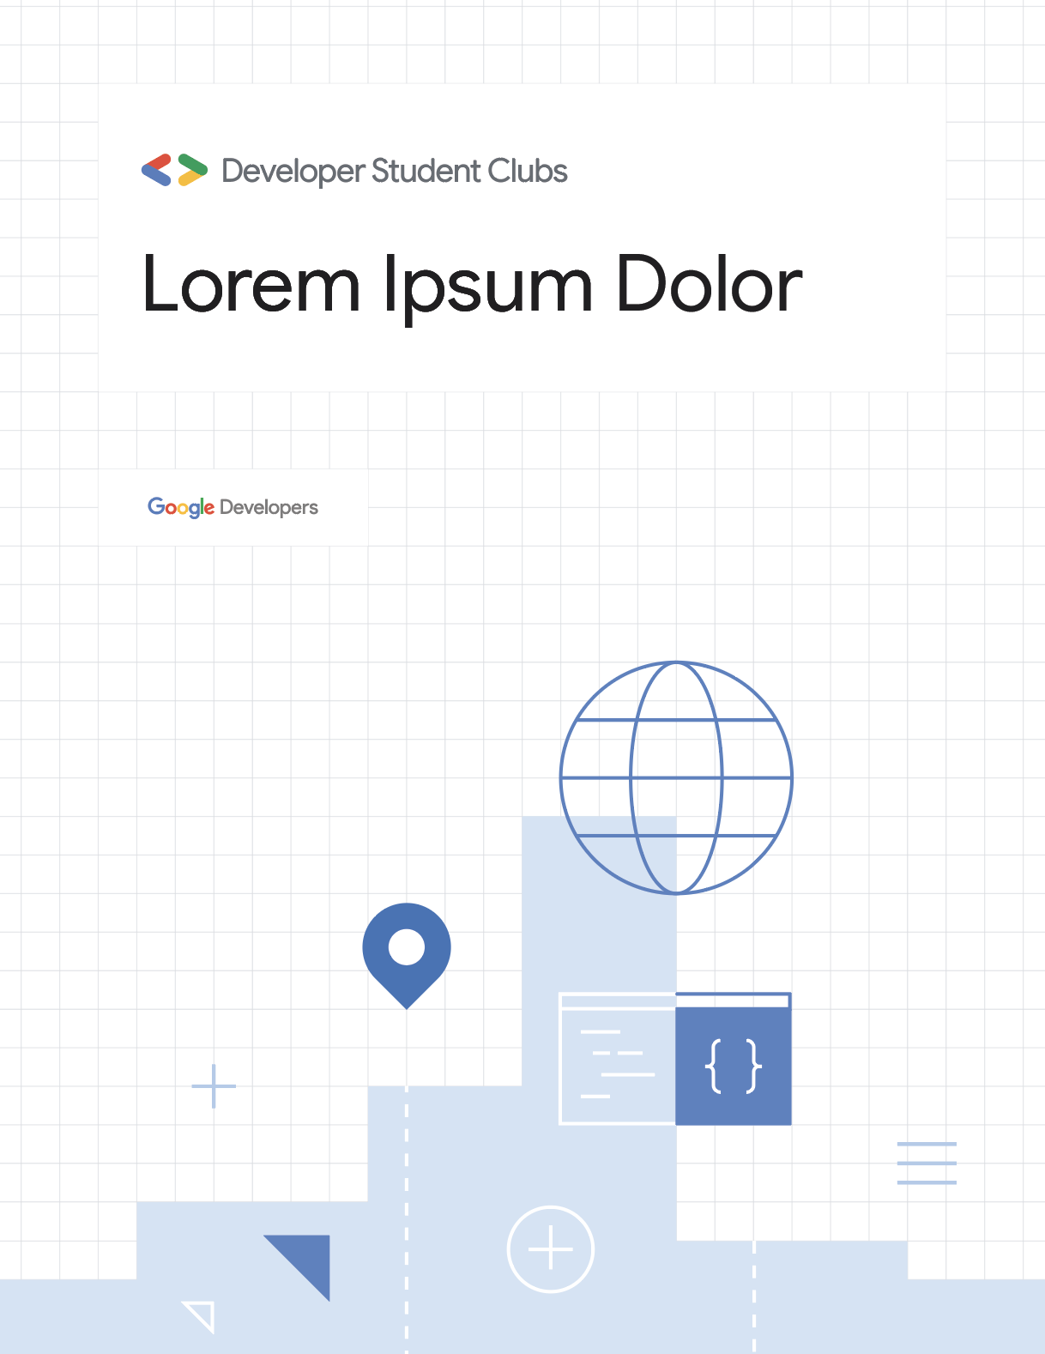
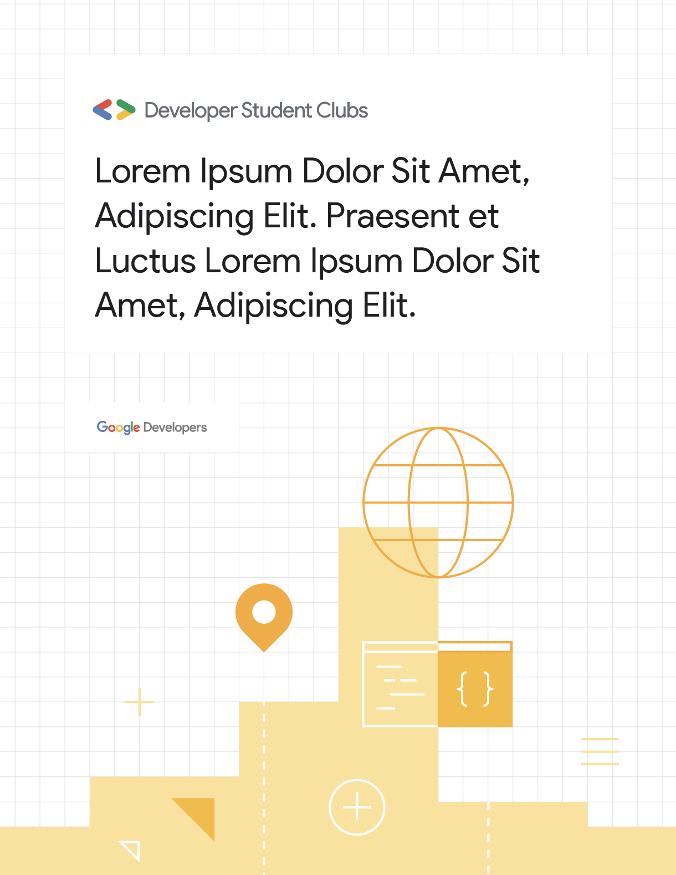
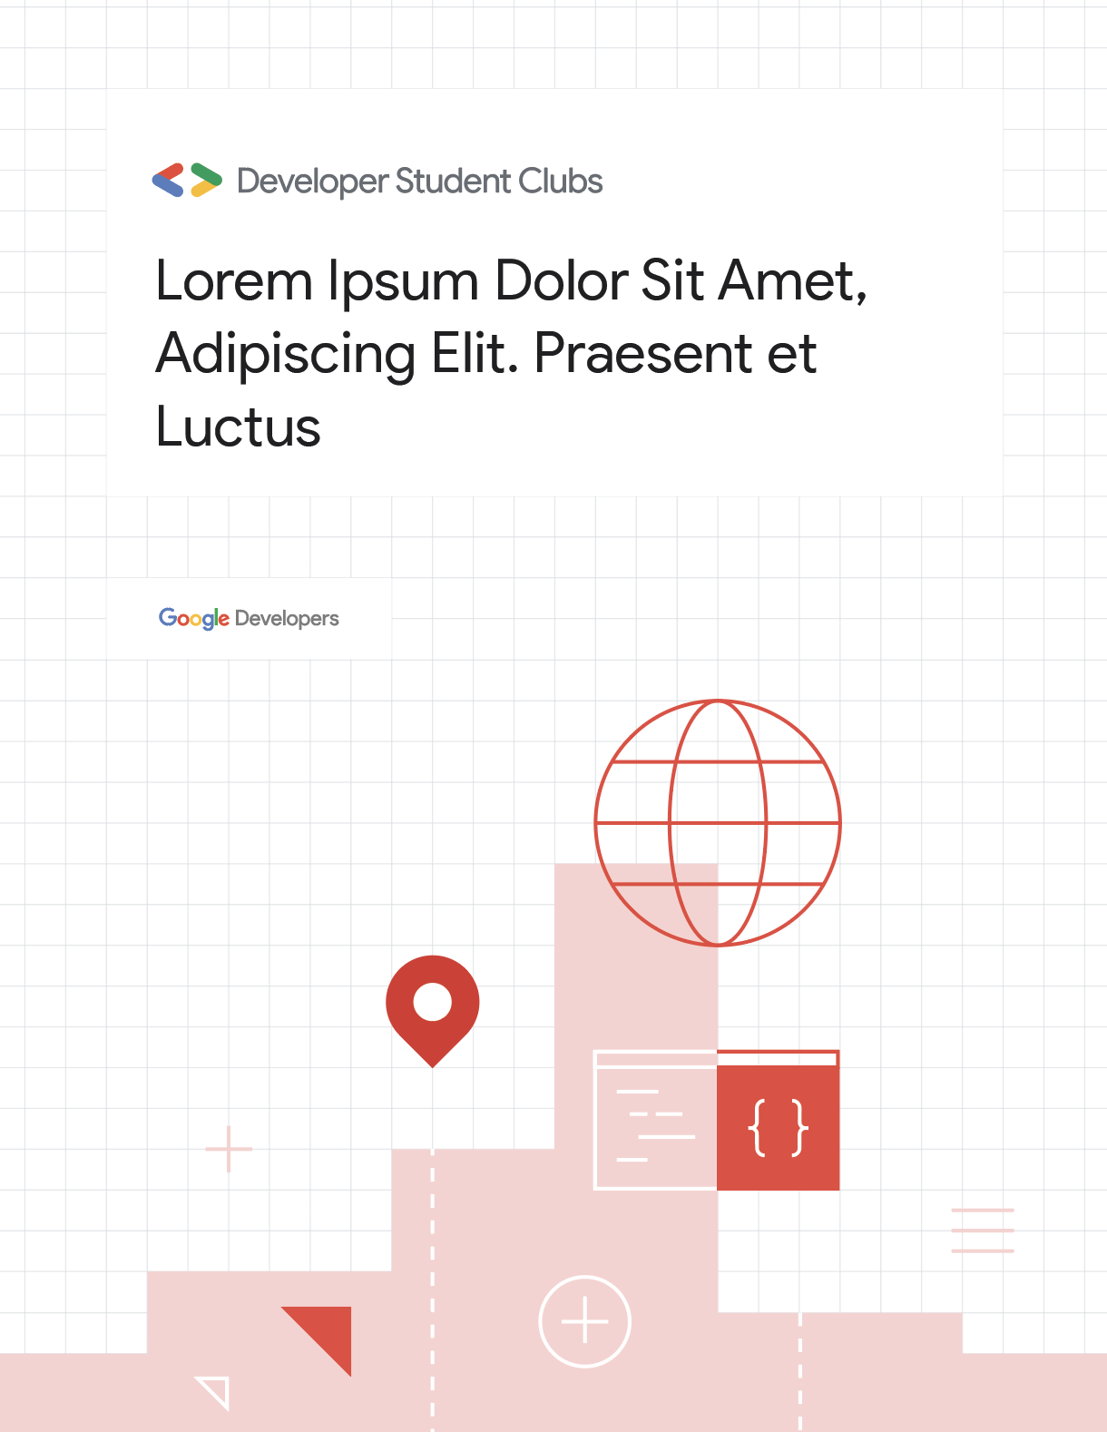
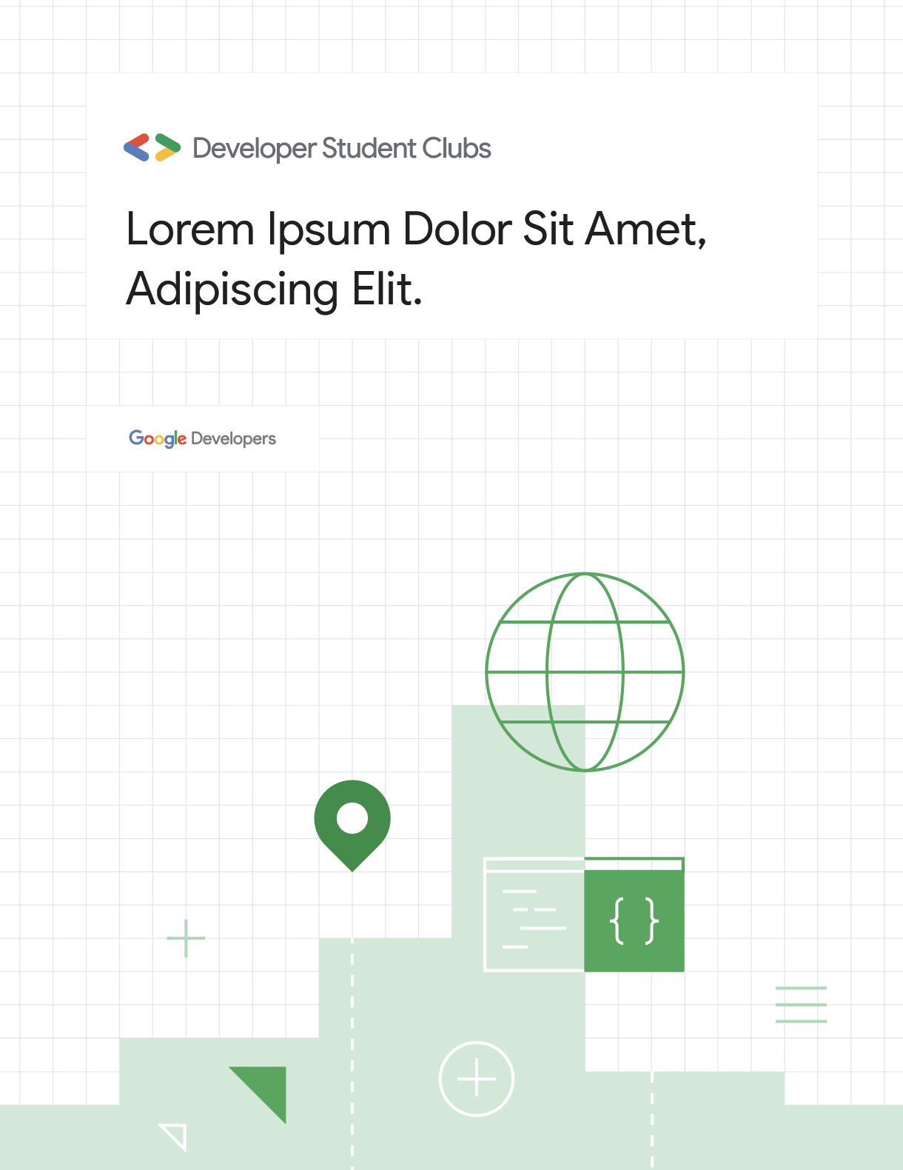
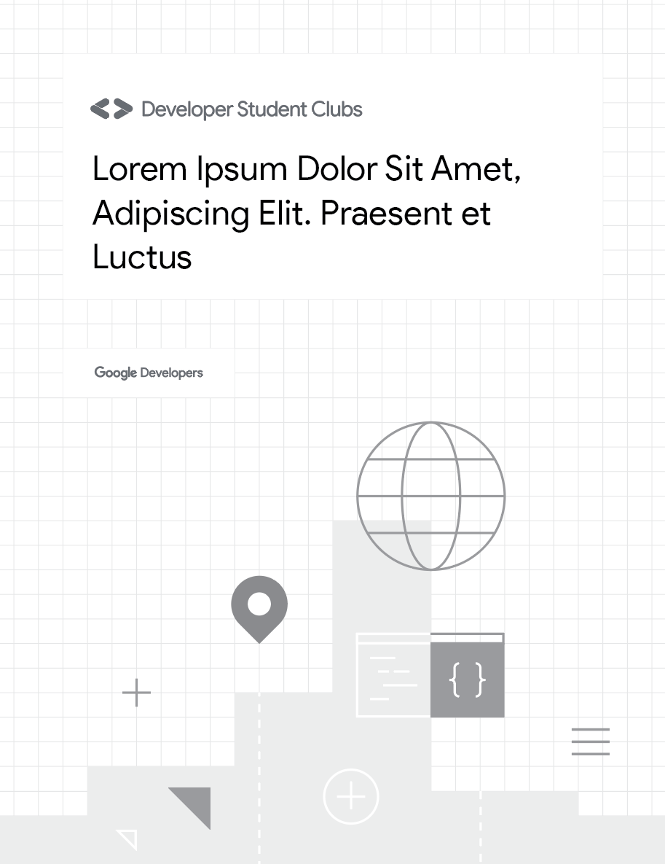
Developer Student Clubs - Brand guide and meetup kit
Event signage - Letter size flyer
Download source files
Use any of the following event signage sizes and formats as desired as a way for your community and attendees to identify your event. These also make a great backdrop for photos!
Standard letter format
8.5’ x 11”
21.5 x 27.9 cm
Use grayscale option when color printing is not available

Slide 30
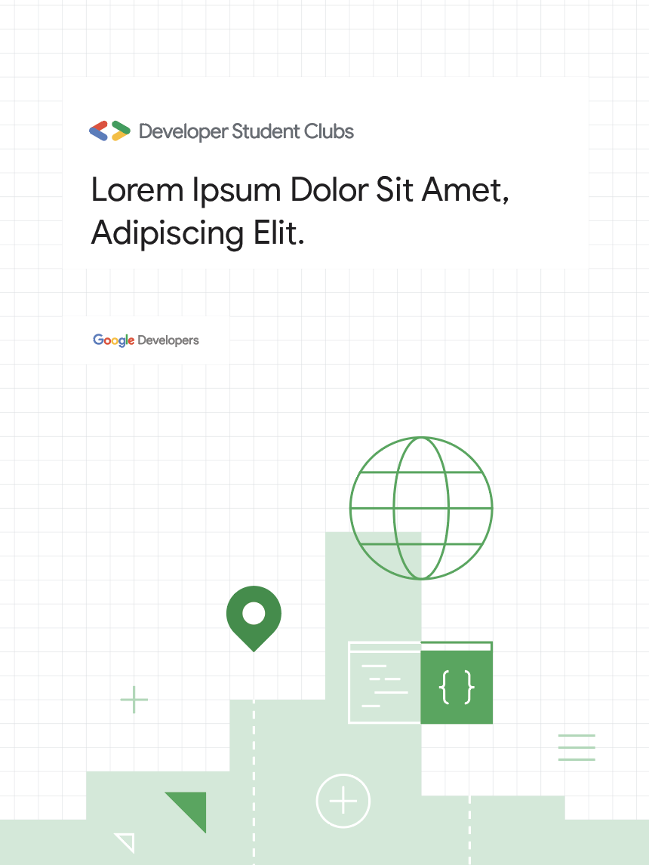
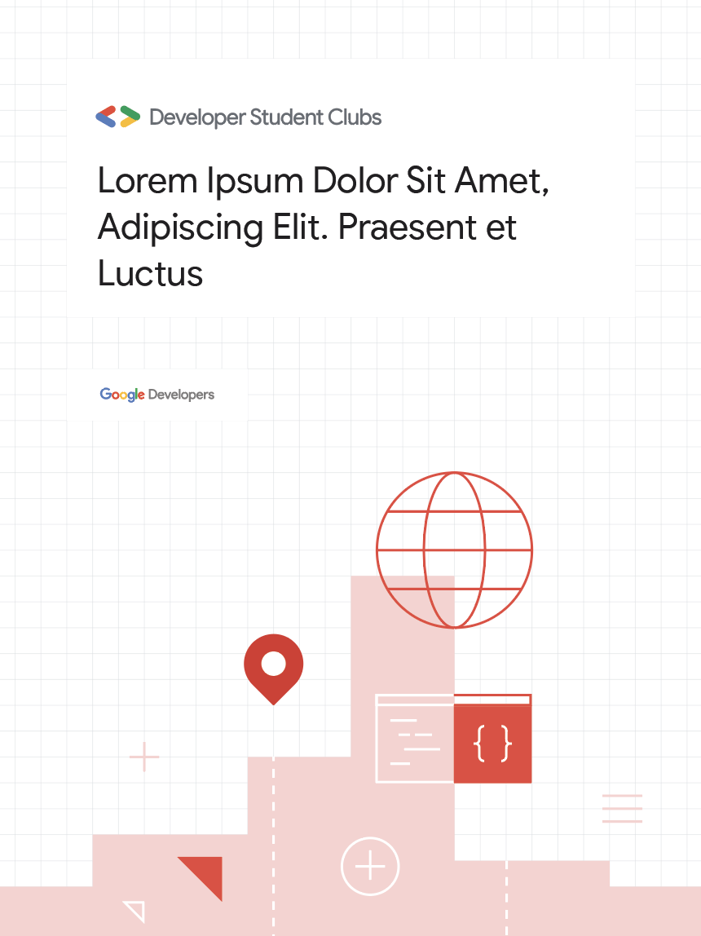
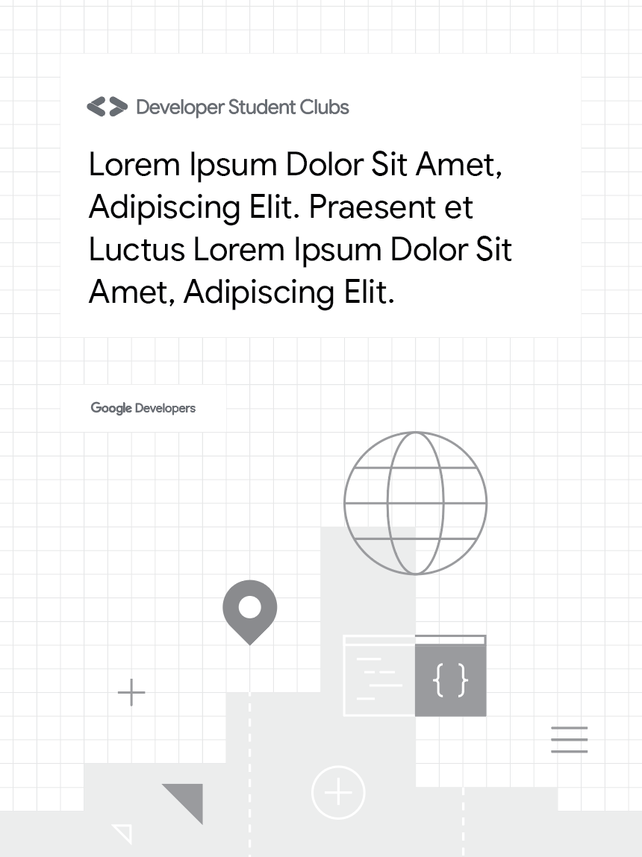
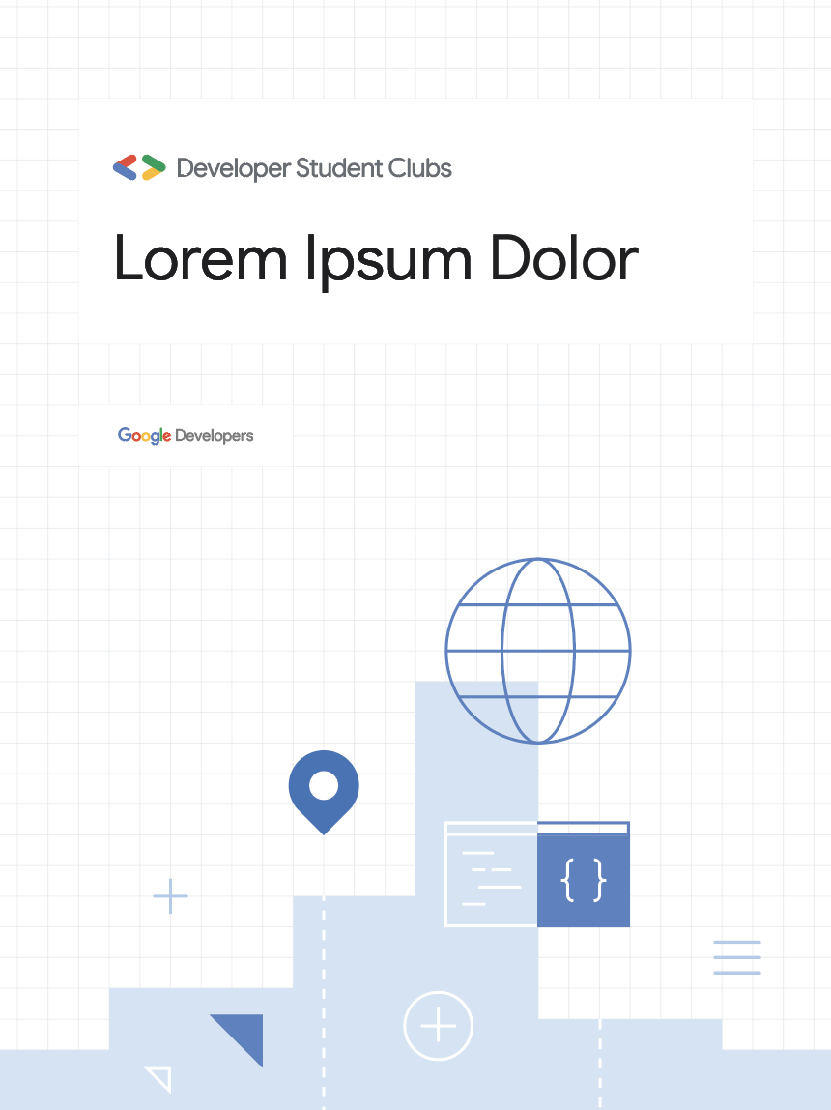
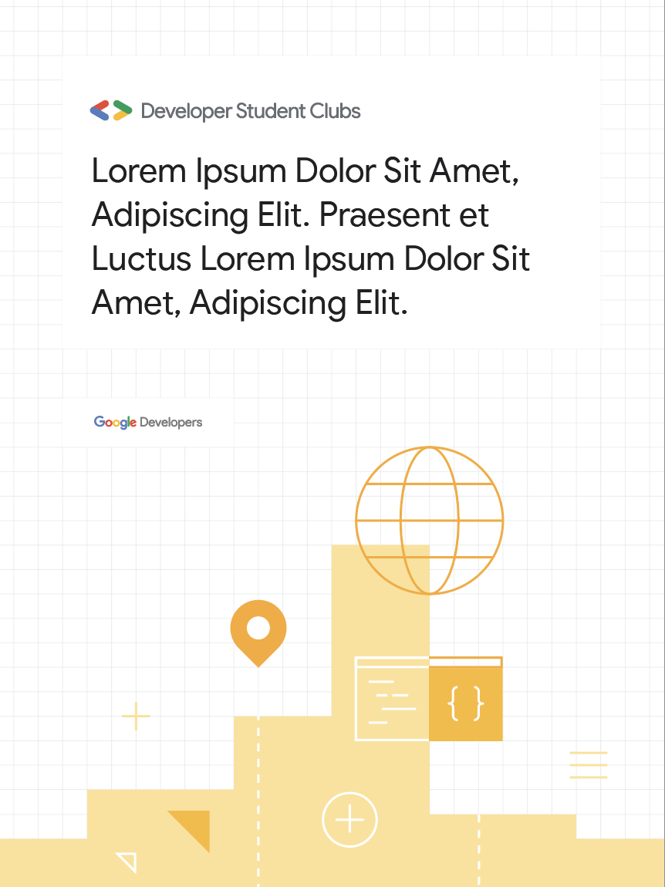
Developer Student Clubs - Brand guide and meetup kit
Event signage - Posters
Download source files
Standard poster format
18” x 24”
45.7 x 60.9 cm
Use grayscale option when color printing is not available

Slide 31
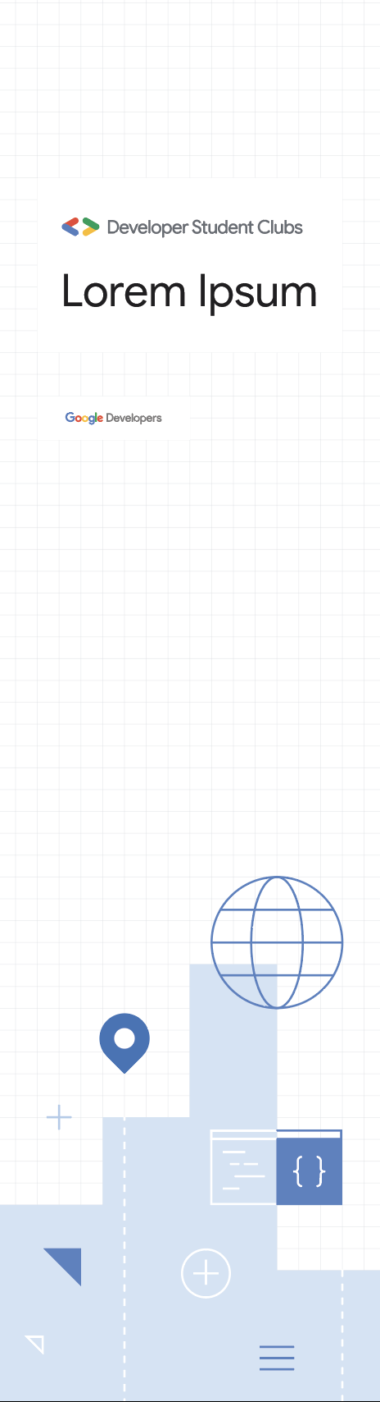
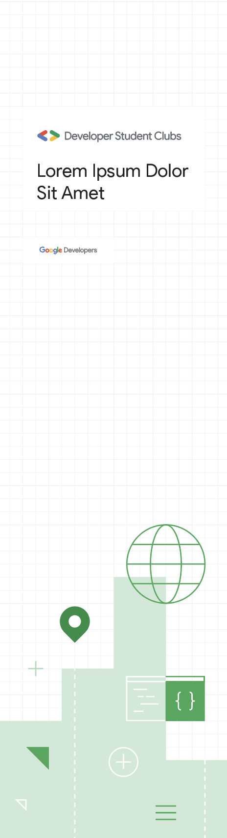
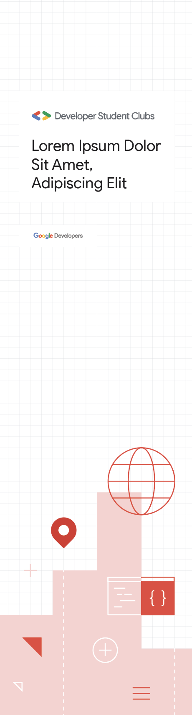
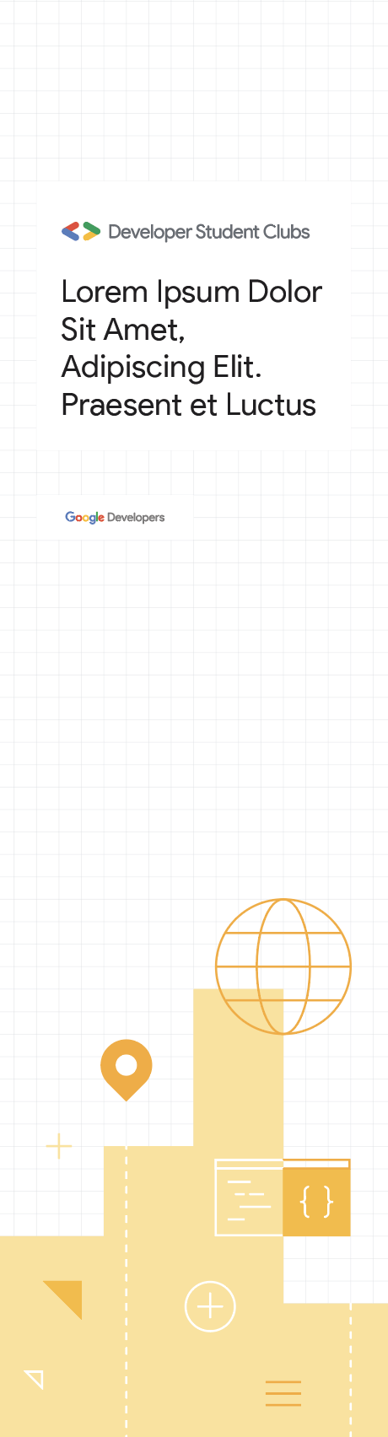
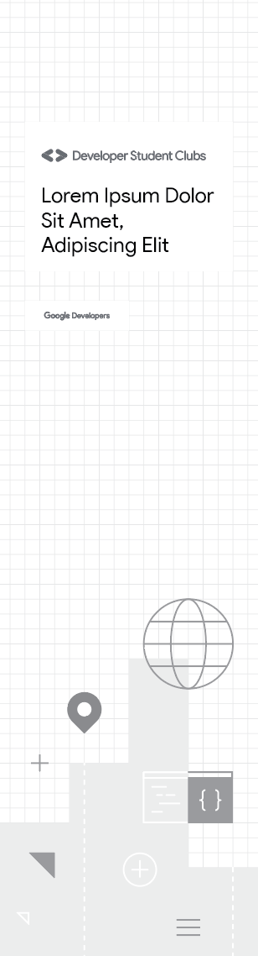
Developer Student Clubs - Brand guide and meetup kit
Event signage - Half meterboards
Download source files
Standard half meter board
26” x 95”
66 x 241.3 cm
Use grayscale option when color printing is not available

Slide 32






Developer Student Clubs - Brand guide and meetup kit
Event signage - Meterboards
Download source files
Standard meter board
46” x 95”
116.8 x 241.3 cm
Use grayscale option when color printing is not available

Slide 33





Developer Student Clubs - Brand guide and meetup kit
Logo printing examples
Download logo files | Chapter lockup generator
If printing the logo on either items such as the ones shown below, keep the logo guidelines in mind.

Slide 34
Thank you!

